Slide 1

SARs Workshop
October 2024

Slide 2


SAR reporting…
SARS Overview | What and Why
FIU Stats | FIU 2024 Stats
GSC Stats | GSC 2024 Stats
Case Studies | Various Case studies – UK and beyond
Typologies | What’s the process?
Red Flags | Red Flags
Who, How & When | Roles, Disclosures, Ongoing monitoring.
How to Improve | Some tips on how to improve SAR reporting
Key Takeaways | Summary & key takeaways
2

Slide 3
SARs – An Overview
Paul Skinner

Slide 4
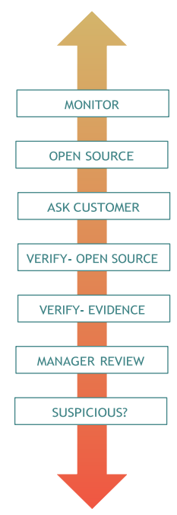
What & Why
A SAR is a report made to the FIU informing it that certain activity (usually, but not always, that of a customer or client) causes knowledge or suspicion of money laundering, or belief or suspicion of terrorist financing.
  Persons conducting business in the regulated sector are required under POCA and ATCA to submit SARs in respect of information that comes to them in the course of their business, if they know or suspect, or have reasonable grounds for knowing or suspecting, that a person is engaged in (or attempting) money laundering, terrorist financing or proliferation financing.

Slide 5
Suspicious / Unusual
No further withdrawals or deposits should be allowed until satisfactory EDD is carried out. Further gaming activity should only be permitted to continue for a period of 7 days for high risk or in the event of any unusual activity provided that the activity is monitored.
This should allow the customer a reasonable amount of time to complete the EDD process, including, where necessary, the customer providing additional information or verification.
If satisfactory EDD is not completed within 7 days or where the activity is suspicious, the account should be locked.

Slide 6
FIU Stats
In Q2 of 2024, the FIU received 26 reports from the gaming sector, a decrease of 91.56% from Q1. These used to be from only 1 entity.
For the majority of reports made, the suspected predicate offence was unknown (65.38%).
This was followed by fraud (26.92%), drug trafficking (3.85%), and organised criminal activity (3.85%).
No reports received from the sector suspected criminality that occurred within the Isle of Man.

Slide 7
SUSPICIOUS ACTIVITY REPORTS
TERRESTRIAL
INTERNAL
EXTERNAL
1
Q1 2023
2
1
Q2 2023
3
2
Q3 2023
3
2
Q4 2023
2
0
Q1 2024
0

Slide 8
Typologies
Stephen Corlett

Slide 9
Case Study – AUSTRAC Vs Crown
July 2023 the Federal Court of Australia penalised Crown Melbourne and Perth casinos with a $450 million fine over two years for contravening the AML/CFT Act 2006 between 2015 – 2022.
Some of the areas that Crown’s Melbourne and Perth casinos breached the Australian AML/CFT Act:
failed to implement transaction monitoring appropriate to the nature, size and complexity of their business;
lacked appropriate procedures that ensured higher risk customers were subject to extra scrutiny and monitoring in their EDD programmes;
failed to appropriately identify, timely assess and respond to ML/FT risks they faced; and
failed to appropriately monitor billions of dollars in transactions impacting ability to identify, report and disrupt possible suspicious activity.
According to Reuters, the court filing listed 547 total contraventions and noted that each violation carried a fine of up to A$22.2m.
Notes:
Sources:
https://complyadvantage.com/insights/austrac-starts-federal-proceedings-against-australias-largest-casino-operator/
https://www.austrac.gov.au/inside-austrac-vs-crown-case-key-takeaways-and-insights
https://baselgovernance.org/blog/crown-resorts-anti-money-laundering-fine-wake-call-gambling-industry
https://www.theguardian.com/australia-news/2023/jul/11/crown-to-pay-450m-fine-in-interest-free-instalments-after-breaching-anti-money-laundering-laws#:~:text=Crown%20admitted%20it%20failed%20to,about%20550%20high%2Drisk%20customers.

Slide 10
Case Studies – UK Bookmakers
In 2013, dealers talked to The Guardian about laundering drug money through FOBTs. Lose a little before cashing out and if stopped by police the ‘winnings’ ticket would give a reason for carrying lots of cash. Knew to gamble 40% of the float money or an alert would flag, and to vary loss amounts to not make bookies ‘nervous’. Criminals will always be trying to avoid acting suspicious.
Between 2016-2017, a UK gang robbed cash in-transit-vehicles and laundered their takings through bookies’ FOBTs. Bookmakers only realised it occurred at the end of the working day, showing it’s important to be aware and alert to suspicions and logging SARs if necessary.
In 2013 Coral were ordered to pay back £90,000 it made from a customer who used money linked to drug dealing activities. Coral did submit a SAR, but little to no challenge was made even though there were extensive opportunities to do so. Even gave the customer a complimentary day at the races. Shows that duties and responsibilities don’t just stop following the report of a SAR.
Notes:
Sources
https://amp.theguardian.com/uk-news/2013/nov/08/gambling-machines-drug-money-laundering-bookies
https://www.casino.org/news/uk-armed-robbery-gang-that-laundered-money-through-fixed-odds-betting-terminals-sentenced/
https://www.theguardian.com/society/2013/oct/07/bookmaker-coral-gambling-commission-money-launderer

Slide 11
Case Study Example
Person 1 enters with couple of hundred pounds in cash and seems to have a mixture of English and Scottish notes.
Yourself or another remember of staff don’t spot anything out of the ordinary but do start to notice the same person coming in more regularly and betting with the same mixture/amount of funds.
The individual sometimes only has minimal betting activity spending 10/15 minutes there during their visits which are between 12-1pm, seemingly on their lunch hour, cashing out with a slight loss or win majority of the time.
As they come in more often you get to know them more or feel as if you know them, maybe chat about families, their business etc., where they like to go on about how they’ve recently become self-employed, and business is going well.
What are the potential red flag(s)/suspicions here?

Slide 12
Case Study Example
Mix of English, Scottish, Irish bank notes - customers using large amounts of these banknotes to then withdraw quickly/in large amounts of Manx notes helps disguise the origin of the funds.
Regular visits below threshold – customer may be aware of thresholds and make regular visits with smaller amounts of cash to attempt to avoid thresholds and the requirement to be verified.
Minimal play with large/quick transactions – customer may be using funds acquired from a crime to then withdraw the funds as ‘winnings’ to create a legitimate origin of the funds.
You feel you know them personally – although it can help to understand the customer and their habits, this does not qualify as ‘actual’ proof and is not a substitute for physical evidence of wealth.

Slide 13

Red Flags
High value bets/stakes inconsistent with what you believe that customer (if known) is capable of.
Use or attempted use of fake IDs/other people’s IDs.
Third-party betting – use of third parties/agents to disguise source or ownership of money.
Unusual Behaviour – suspicious behaviour, making unusual bets e.g. betting on both sides.
(Casino) Customer leaving large amount of funds on their account for a long period of time
Attempting to use dyed notes.
Customers attempting to bribe, influence, or conspire an employee to avoid requesting CDD or further verification documentation.
Customers transferring funds/chips (Casino) or a betting slip (bookmaker/LBO) to another individual for them to cash out.
Customers from high-risk jurisdictions spending large amounts of cash.

Slide 14
Who, How & When?
Alexander Sapunov

Slide 15
Roles
AML/CFT Compliance Officer
AML/CFT Compliance Officer is responsible for monitoring and testing the compliance, including in ensuring that documented arrangements (i.e. policies and procedures) manage the risks identified in the BRA.
The operational performance of these arrangements (policies and procedures) is monitored – i.e. are these processes effective.
The AML/CFT Compliance Officer effectively must ensure that the business is compliant with the Code requirements.
MLRO
Is responsible for exercising its functions in relation to the Reporting procedures
  E.g. How & whom to report.

Slide 16
MLRO
Reporting Chains
Are all new staff are aware of who the MLRO and if applicable DMLRO are?
Should be part of the induction training.
Information and Internal Disclosures
When a disclosure is made the MLRO must:
  consider the disclosure, decide whether an external disclosure needs to be made.
  Are there reasonable grounds for knowing or suspecting that the activity relates to ML/TF/PF?
Full access to all of the information, and must report to the FIU as soon as practicable.
If there is sufficient information you should report to the FIU there and then
  You can always add additional information to the disclosure later after submission (I believe it’s the Further Information Tab on Themis).

Slide 17
MLRO
Why is having access to information important?
Where an internal SAR lacks information in the first instance, a further review of the available information should be.
An internal SAR was given to you in relation to a player which notes that the player deposits frequently low value funds and bets on low-risk games only once to withdraw and passes over the winning ticket or chips to a friend.
Has the player had a history of doing this in the past? Was this raised whether formally or informally before? Was the explanation / rationale adequate? What is known about the player?
So today or tomorrow please do take some time to consider if you do have access to everything you need, as without this you will not have a full picture.

Slide 18
Disclosures
Registers of Disclosures
You must have (even if no disclosure have been made yet) registers of disclosures.
Minimum of 3 registers
  These are internal disclosures, external disclosures and any other disclosures made to the FIU.
The registers must include:
(a) the date on which the disclosure is made;
(b) the person who made the disclosure;
(c) for internal disclosures, whether it is made to the MLRO or deputy MLRO;
(d) for external disclosures, the reference number supplied by the Financial Intelligence Unit; and
(e) information sufficient to identify any relevant papers or records

Slide 19
Internal disclosures
Where it was identified that suspicious activity has been identified, you must conduct EDD unless you reasonably believe that in doing so would tip-off the customer.
If the decision is made not to conduct EDD for the said reason, you must record this as an internal disclosure must still be made and you have to reflect this.
EDD must also be conducted where unusual activity is identified, this includes instances where:
(a) the transaction has no apparent economic or lawful purpose, including a transaction which is— (i) complex; (ii) both large and unusual; or (iii) of an unusual pattern;
(b) you become aware of anything that causes you to doubt the identity of a person you should be identifying;
(c) the operator becomes aware of anything that causes the operator to doubt the good faith of a customer or known beneficial owner

Slide 20
Enhanced due diligence includes—
(a) considering additional identification information;
(b) considering additional aspects of the identity of the customer and any known beneficial owner need to be verified & obtaining them;
(c) establish the source of wealth of a customer;
(d) further research, in order to understand the background of a customer and the customer’s business; and
(e) additional ongoing monitoring should be carried.
Where EDD is outstanding the relevant transaction must go no further and you must terminate the relationship if EDD is not provided. Where EDD is not provided you must consider making a disclosure to the FIU.
No more than 7 days should be given for EDD to be provided.

Slide 21
External Disclosures
Where MLRO / DMLRO are suspicious or have reasonable grounds to suspect ML/TF/PF you must disclose this to the FIU.
The FIU’s functions include:
(a) receiving, gathering, analysing, storing and sharing information about financial crime (whether in the Island or elsewhere);
(b) assisting with the prevention and detection of crime, and in particular, financial crime (whether in the Island or elsewhere);
(c) cooperating with law enforcement agencies; and
(d) contributing to the reduction of crime, and in particular, financial crime and to the mitigation of its consequences.

Slide 22
Ongoing Monitoring
Where you identify any unusual activity in the course of an ongoing customer relationship or occasional transaction, you must, within a reasonable timeframe—
(a) perform appropriate scrutiny of the activity;
(b) conduct enhanced customer due diligence; and
(c) consider whether to make an internal disclosure.
The extent and frequency of any monitoring under must be determined—
(a) on the basis of materiality and risk of ML/FT;
(b) in accordance with the BRA and
(c) having particular regard to whether a customer poses a higher risk of ML/FT.

Slide 23
Ongoing Monitoring
The training must, among other things include:
(a) the provisions of the AML/CFT legislation;
(b) any personal obligations in relation to the AML/CFT legislation;
(c) the reporting procedures and controls;
(d) your policies and procedures and controls for AML/CFT
(e) the recognition and handling of unusual activity and suspicious activity;
(f) the staff’s personal liability for failure to report information or suspicions in accordance with internal procedures and controls, including the offence of tipping off; and
(g) new developments, including information on current techniques, methods and trends in ML/FT.
Training must also be provided where significant changes have been made to the legislation or your policies and procedures.
Ultimately it is the staff that will identify suspicious or unusual activity.

Slide 24
Reporting & Overview
Charis Bennett

Slide 25
Reporting a SAR to the FIU
1) Clear
- Identify the correct legislation, explain, Include all documents.
2) Detailed
- Names, previous names, DoB, Addresses, nationality, ID documents.
3) Timely
- “As soon as Practicable”
SARs made by businesses in the regulated sector, and authorised disclosures under section 154 of POCA (see paragraph 3.1), must be made using to the FIU using themis available on the website: disclosures.gov.im.
Further information relating to Themis, including a guide for users, is available on the FIU website.

Slide 26




HOW TO IMPROVE?
Ensure your policies and procedures include a tailored approach to your business on how to report.
Ensure staff are appropriately trained to detect unusual and suspicious activity.
Monitor and test compliance with AML/CFT legislation
Encourage staff to report their suspicions

Slide 27

Key Takeaways
Ensure staff are given training which is bespoke to the reporting procedures of the operator and IOM Code - with a clear reporting line.
Ensure staff have read, understood and have immediate access to policies and procedures – consideration to translate the document for those who can't read English
Consideration should be given to whether the information is unusual, suspicious or could assist the FIU – Think of the bigger picture
Operators must evidence an internal disclosure was considered (when CDD/EDD is not provided) – a recorded rationale (this includes the reasons for not submitting)
The MLRO and DMLRO must have access to Themis and should regularly log in to ensure they can report external disclosures when required and review any alerts. All SARs must be submitted as soon as practicable
Maintain a strong compliance culture. Continually review the current reporting processes - are they fit for purpose, has the MLRO/DMLRO received no internal disclosures, sudden decrease of disclosures etc. Any issues relating to time, access, or resources by the MLRO should be identified at the earliest opportunity by the MLRO and Board members to ensure they are adequately resourced to discharge the functions of the role.

Slide 28




Thank You…
gscamlinspections@gov.im
www.isleofmangsc.com
Isle of Man Gambling Supervision Commission

Slide 29
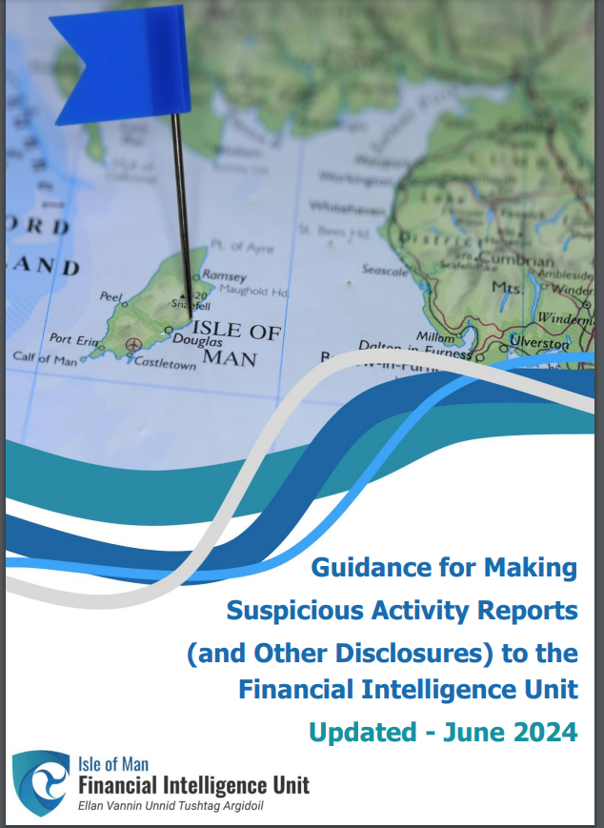
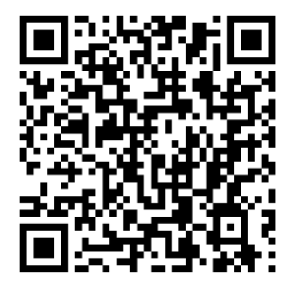
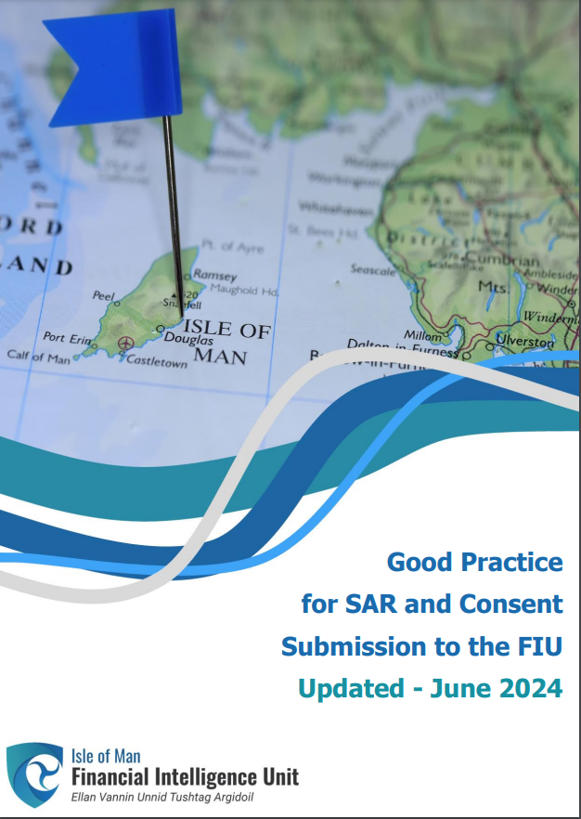
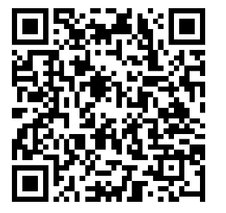

Guidance for making SARs to FIU (June 2024)
https://www.fiu.im/media/1228/sar-guidance-updated-june-2024.pdf
Good Practice for SARs and Consent to FIU (June 2024)
https://www.fiu.im/media/1229/sar-good-practice-updated-june-2024.pdf
https://www.fiu.im/
Notes:
Guidance on SARs
The FIU has a dedicated support team, available on +44 (0)1624 686000 during office hours (9am – 5.00pm (GMT), Monday to Friday), to deal with Themis queries.

