Slide 1

GSC AML Forum
31st January 2025

Slide 2

Welcome

Slide 3
Agenda
GSC Update | An update on the GSC.
Enhanced Due Diligence – Overview and Best Practices | EDD – An overview of key points highlighted by the inspections team including case studies and best practices to consider.
SARs Update | An update on SARs data from GSC Operators.
Outreach Overview | A brief overview of GSC Outreach in the previous 6 months.
~~~~~~~~Break~~~~~~~~ | Break for refreshments
Guest Speaker – Cyber-Crime, Ransomware and Sanctions. | Guest presentation on Cyber-Crime, Ransomware and Sanctions - Office of Cybersecurity.
Closing Statements | Closing Statements

Slide 4
GSC Overview
31st January 2025

Slide 5
GSC Update

Slide 6
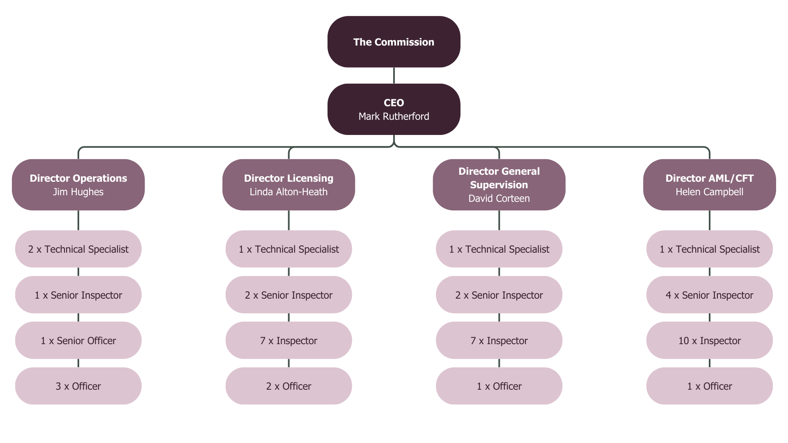
GSC Structure

Slide 7
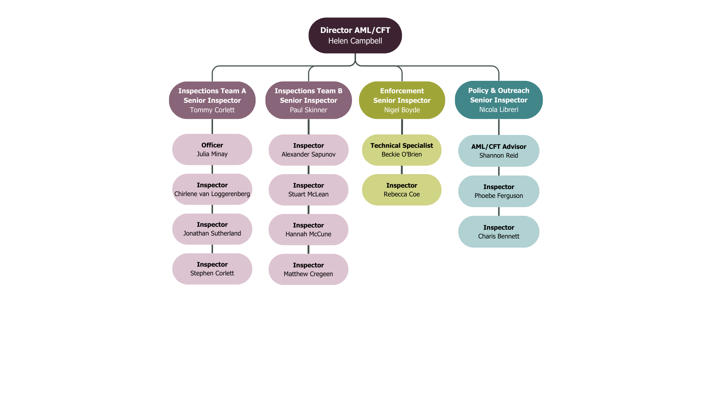
AML/CFT Division

Slide 8
Enforcement - Governance
GSC Enforcement Strategy – “Holding any licence issued by the GSC imposes upon that licence holder a requirement and expectation that it seeks to achieve the highest standards of regulatory compliance, governance and risk management”.
CSP sourced directors are, per FSA guidance, “are subject to certain minimum standards of care, skill and diligence in discharging their duties. As a general rule, the standard applied will be that of the “reasonable man test”. It should be noted that a higher standard is likely to be applied to a person who offers his services as director as a profession or by way of business”.
Governance isn’t one size fits all.
Recruit the right people.
Be able to demonstrate good Governance, including over your staff/ experts/ consultants.
Individual accountability is real!

Slide 9
AML/CFT Related Developments
Legislative changes previously discussed (entry controls, risk-based approach, etc.).
Responses to emerging typologies and evolving threat landscape.
Improvements to GSC data sharing.
Focus on network partners.
National Risk Assessment work is ongoing.

Slide 10
Enhanced Due Diligence
31st January 2025

Slide 11


Why?
The significance of KYC (Know Your Customer) in a risk-based anti-money laundering programme lies in its ability to identify and mitigate money laundering or terrorist financing risks, thereby preventing criminals from exploiting your products and services.
KYC informs other crucial AML processes, such as transaction monitoring; by understanding the intended use of the account, you can determine whether the activity is commensurate or unusual for that customer. By collecting data on customer, it will help ensure effective screening against sanctioned lists and identifying politically exposed persons (PEPs).
Its important any due diligence obtained in scrutinised and recoded to establish if you are comfortable or concerned about the customer.
Therefore, requesting and obtaining Enhanced Due Diligence (“EDD”) is a crucial measure in identifying and mitigating higher ML/TF risk.
Legal Requirement:-
Paragraph 8 (8) (RBA) of the Gambling (AML/CFT) Code
Paragraph 14 (1) (EDD) of the Gambling (AML/CFT) Code

Slide 12
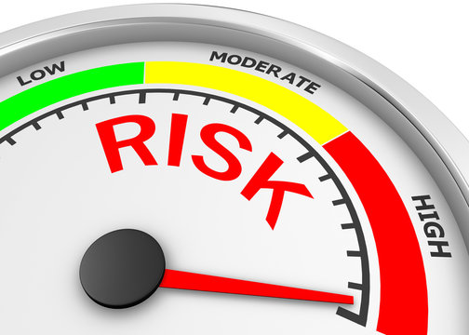
EDD – Code Requirements
When
When must EDD be conducted
Any customer identified as high risk must be subject to enhanced customer due diligence
In the event of unusual activity
PEP
In the event of any suspicious activity, unless the operator reasonably believes conducting enhanced customer due diligence will tip-off the customer
A customer who poses a higher risk of ML/
TF as assessed by the CRA
Customers resident in “List A” jurisdiction
Customer that are the subject of an AML/CFT warning
Additionally, operators should consider getting EDD for other higher risk factors including but not limited too:
Cryptocurrency users
P2P Transfers
Multiple payment methods
Resident or located in “List B” jurisdiction
Legal persons, arrangements or customers acting by way of business#
High-net-worth individual (HNWI)
Sporting Professionals

Slide 13





EDD – Code Requirements
An operator must establish, record, maintain and operate appropriate procedures and controls in relation to undertaking enhanced customer due diligence.
Enhanced due diligence includes—
EDD
Consideration for additional identification
considering additional aspects of the identity of the customer and any known beneficial owner need to be verified by reliable independent source documents, data or information, and, where it is considered necessary, the taking of reasonable measures to obtain such additional verification
reasonable measures to establish the source of wealth
the undertaking of further research, where considered necessary, in order to understand the background of a customer and the customer’s business; and
considering what additional ongoing monitoring

Slide 14
Enhanced Due Diligence
High risk customer
Review risk assessment
1
What factors have contributed to the risk assessment?
CDD Information
2
Is more information needed to manage the risk?
Verification of Information
3
Is more verification (or evidence) needed?
Source of Wealth
What activity has taken place & in what period?
How can information be obtained?
Can I rely on this information?
4
Do I need to keep a closer eye on this customer?
Does the information obtained under 1:4 remain appropriate for the activity seen?
Ongoing Monitoring
5

Slide 15



Source of Wealth

Slide 16

Source of Wealth (“SOW”)
Why?
Paragraph 14 (2)(c) – ‘the taking of reasonable measures to establish the source of wealth of a customer “SOW” refers to the origin of the customer’s entire body of wealth. The operators should take “reasonable measures” to establish the source of wealth of a customer.
Observations (The Inspectorate have found examples of)
Bank statements being provided as Source of Wealth showing transaction history, with no additional commentary Whilst an operator conducted a useful SOW risk assessment, by asking the customer relevant SOW questions it failed to validate or corroborate the customer statement with documentary evidence. No source of wealth requested for high-risk customers A failure to scrutinise information and identify the customer as a PEP based on the SOW provided A detailed synopsis of customer analysis with pay slips, bank statements, detailed open-source searches and review of the customers spending behaviour and rationale
Best Practice
Obtaining and scrutinising pay slips – checking the dates, employer, and establishing if commensurate to spending behaviour Recording the open-source searches, whether positive or negative results, validate information Recording detailed back-office notes to demonstrate the steps take and the outcome. Consider the factors that resulted in the customer being deemed high risk, the value of the customer’s transactions, and the period over which the transactions occurred when determining “reasonable measures”.

Slide 17
Best Practice continued (SOW)
Best Practice
Customer unable to prove source of wealth due to being a professional gambler Operator undertook extensive public domain checks to find that the customer was a successful poker player. High roller customers do not react well to being questioned about source of wealth when they hit internal triggers Operator changed approach. VIPs welcomed via personal phone-calls. Personal touch and subtle questions backed up with public domain info. Another operator commissioned detailed 3rd party EDD reports which were reviewed carefully and any issued picked up with the customer. Open-source checks rather than direct customer contact in the first instance Operator used various public domain sources to build a picture of the customers wealth including; occupation, average salary for that occupation, house prices in area. Customer claimed source of wealth was inheritance from recent bereavement. Operator was not included to request documentary proof unless absolutely necessary. Managed to find obituary notices that supported the explanation.

Slide 18
Recording the steps taken

Slide 19
Recording steps to demonstrate basis
Why?
Paragraph 14 (EDD) An operator must establish, record, maintain and operate appropriate procedures and controls in relation to undertaking enhanced customer due diligence. Paragraph 15(Ongoing monitoring) An operator must record any examination, steps, measures or determination made or taken [regarding ongoing monitoring of customers]. Its important the operator evidences the measures it has taken, not only to demonstrate its regulatory obligations but to help staff or any internal/external investigation understand the decision-making process.
Observations (The Inspectorate have found examples of)
Polluted risk rating with no separation of risk ratings for problem gambling and AML. High risk recorded on back office, but this is not for AML. The operator created a simple, easy to understand, flow chart or graphs for compliance staff to understand expectations per risk rating and documentation required The operator overestimating its own expectations for collecting EDD within its policies and procedures, advising it would conduct open source searches however no evidence found, resulting in a deficiency. A failure to clearly demonstrate the reasons for requesting EDD and at each step of the process including the outcome/determination Confusing when using acronyms, ‘POI’ referenced differently as ‘Proof of ID’ and ‘Proof of Income’ by same operator
Best Practice
Keep it simple – don’t overcomplicate the process. It must be easy process for compliance staff to understand and achievable. Clear and distinguishable risk ratings –ie ‘AML High’ or ‘High (PG)’ recorded on back office and within the policies and procedures Record the steps taken at each process and the outcome – this includes any reviews If using acronyms, ensure you provide a table of reference to prevent discrepancies

Slide 20

Summary
The customers recorded as high risk must undergo EDD
Ensure policies and procedures are aligned with the Code requirements
Ensure the EDD process is clear to understand and is achievable
Obtain and scrutinise SOW documents to establish if its commensurate with the customer’s spending behaviour
Detail any open-source searches conducted
Record any reviews or steps taken on a customer account to demonstrate the EDD Code requirements have been considered. A summarised review of the EDD documents and the determination is a good method of evidencing this.
Ensure the back-office notes are clear and risk ratings are distinguishable

Slide 21






Gambling (AML/CFT) Code 2019
AML/CFT Guidance Notes highlights
No further withdrawals or deposits should be allowed until satisfactory EDD is carried out.
Further gaming activity should only be permitted to continue for a period of 7 days
Activity should be monitored for customers found with unusual activity.
If satisfactory EDD is not completed within 7 days or where activity is suspicious, the account should be locked.
Customer relationship, transaction proceeds no further, terminating the ongoing customer relationship and disclosure
Customer is assigned AML high risk
7 days to provide EDD
Account is suspended until documents are received
EDD threshold

Slide 22



Case Study
Customer relationship, transaction proceeds no further, terminating the ongoing customer relationship and disclosure
Customer is assigned AML high risk
7 days to provide EDD
Account is suspended until documents are received
Procedures
EDD threshold
Day 85 the Operator closed the account.
Customer is assigned AML high risk level
The account was not suspended
46 days passed
The customer triggered the very high-risk rating
The Operator requested high-enhanced EDD
In practice

Slide 23

Case Study
Customer is assigned AML high risk level
Operator gives customer 7 days to provide EDD
Customer requests a 3 moth self-exclusion
Customer returns 7 months later and deposits with the Operator
Account closed
EDD threshold

Slide 24
Case Study
Customer relationship, transaction proceeds no further, terminating the ongoing customer relationship and disclosure
Customer is assigned AML high risk
Operator requests EDD and gives customer 7 days
A reminder after 3 days
A reminder after 6 days
Customer account locked
EDD threshold

Slide 25
Summary
The customer must be recorded as high risk
Reasonable timeframe for providing EDD is considered as 7 days within GSC AML/CFT Guidance
The customer account must be suspended for deposits and withdrawals whilst awaiting satisfactory EDD
If the customer does not provide satisfactory EDD within 7-day timeframe then the account must be locked, the transaction stopped and consideration of terminating the customer relationship and internal disclosure completed
Reminders to the customer within the 7-day timeframe is a helpful way of getting the required information
Follow policies and procedures

Slide 26
Suspicious Activity Reporting
31st January 2025

Slide 27
SUSPICIOUS ACTIVITY REPORTS - ONLINE
INTERNAL
EXTERNAL
107
Q1 2024
8
44
Q2 2024
13
60
Q3 2024
20
64
Q4 2024
21

Slide 28
INTERNAL SUSPICIOUS ACTIVITY REPORTS - ONLINE
B2C
B2B
107
Q1 2024
0
44
Q2 2024
0
60
Q3 2024
0
64
Q4 2024
0

Slide 29
EXTERNAL SUSPICIOUS ACTIVITY REPORTS - ONLINE
B2C
B2B
8
Q1 2024
0
12
Q2 2024
1
20
Q3 2024
0
20
Q4 2024
1

Slide 30
SUSPICIOUS ACTIVITY REPORTS - TERRESTRIAL
INTERNAL
EXTERNAL
0
Q1 2024
0
0
Q2 2024
0
0
Q3 2024
0
0
Q4 2024
1

Slide 31

“Encourage staff to submit SARs”

Slide 32

CASE STUDY: B2B
A manipulated passport was identified by the Inspectorate.
Documents were reviewed by the AML/CFT Compliance Officer.
MLRO was unaware of this.
Disclosure not submitted upon learning document was fraudulent.

Slide 33




SAR REGISTERS
The Code requires 3 registers to be in place.
Registers must be demonstrated during an AML/CFT inspection.
The Code requires you to record specific information on your registers.
Registers should match your Quarterly Returns.

Slide 34
FIU FEEDBACK
Make sure that the relationship between your business and the subjects of the disclosure is clearly defined at the start of the disclosure.
Make sure you clearly state your suspicion.
Make sure that where the “Dual-reported” legislation option is used, you have clearly stated the jurisdiction to which the dual-report has been made.
Make sure that the disclosure contains relevant information only. Keep the report concise and refrain from including extra information where it is not needed (for example detailed information about family members or dependents of subjects where not relevant to the suspicion).
Try not to include details of members of staff within your organisation where not necessary – for example relationship manager names etc.

Slide 35
GSC Outreach
31st January 2025

Slide 36
Outreach Team
Outreach team established in Q1 2024.
Outreach team members,
Nicola
  Phoebe
  Shannon
  Charis
Increasing range & frequency of Output.

Slide 37
You asked…
Would you like to see the GSC conducting more outreach?
Notes:
75% said yes
20% said The current amount was satisfactory.
Only two respondents said ‘No’ to receiving more frequent Outreach from the GSC.

Slide 38
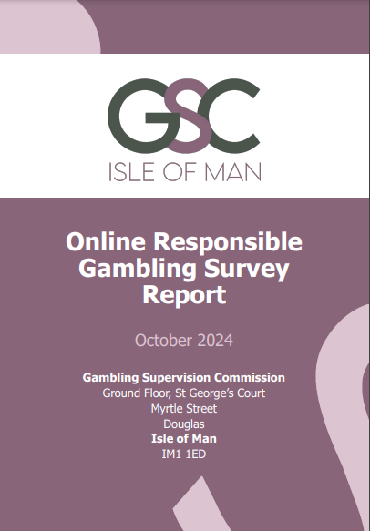
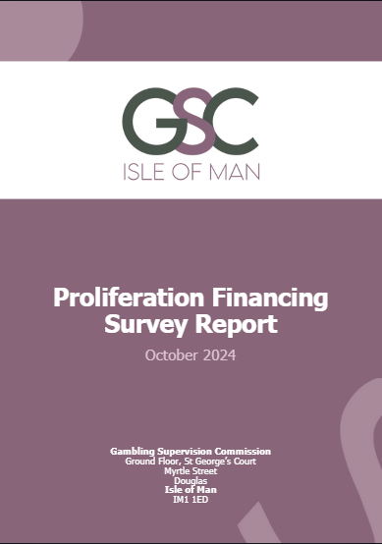
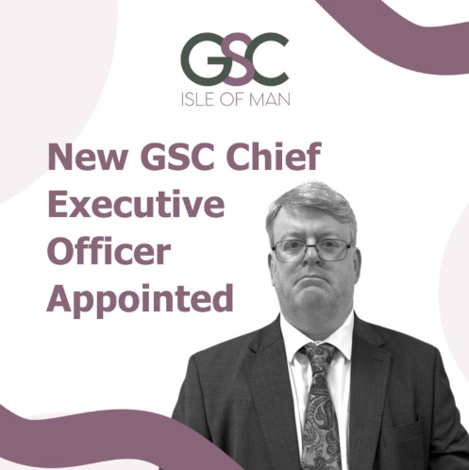
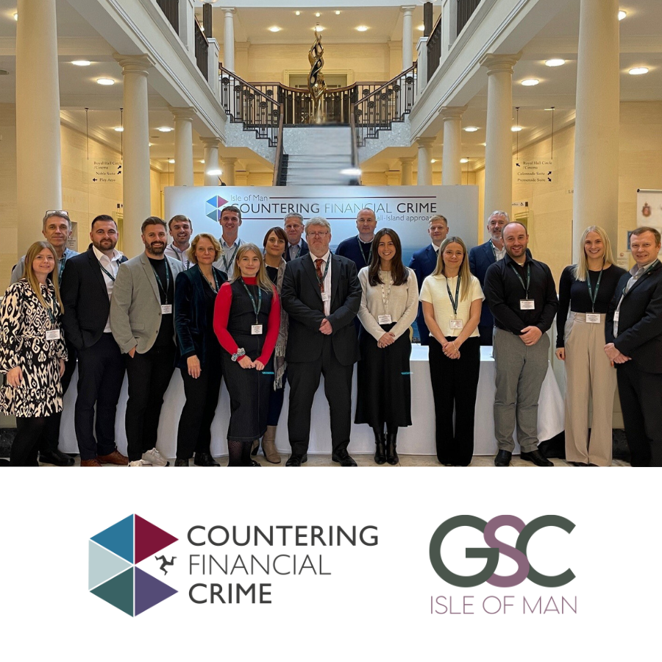
We did.
More frequent Outreach on various channels
  Blog
  LinkedIn
  Email
  Established a periodic Newsletter
Webinars / Video content
  Collaborative videos
  Webinars
  AML Forum recordings
Guidance
  Website & Guidance Updates
  Inspections Guidance Split
Notes:
https://www.isleofmangsc.com/gambling/gsc-gambling-news/03-february-2025-gsc-inspections-methodology-guidance-split/
https://www.isleofmangsc.com/gambling/webinar-videos/

Slide 39
You asked…
As part of the outreach program, considerations being made to have drop-in sessions, is this something you would be interested in?
Notes:
85% of respondents said yes.

Slide 40
We did.
Drop-in Sessions - 17th February!
GSC Office – Derbyhaven Meeting room
1 hour slot
Discuss topic in person
Let us know the topic & preferred time slot well in advance

Slide 41
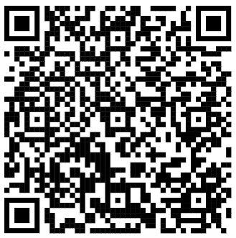
Where to find us…
Blog available under “About the GSC”.
  Press releases, GSC news and Public Statements are available under “GSC News” which can be found on the Gambling homepage
  Webinars and other videos are available under “Videos”
  YouTube Channel - youtube.com/@IOMGSC
LinkedIn updated regularly with GSC updates
  /company/isle-of-man-gambling-supervision-commission
Newsletter
Sign-up Form
Countering Financial Crime LinkedIn page
  /company/isle-of-man-countering-financial-crime
Newsletter Sign-up Form
  https://dashboard.mailerlite.com/forms/1118744/133525586866865391/share

Slide 42
2025
Medium / Date | January | February | March | April | May | June | July
Event | 31st 22ND AML Forum | 17th Drop-In Session |  |  |  |  | 18th 23RD AML Forum
Webinar / Workshop | WEBINAR | WEBINAR | WEBINAR | WEBINAR | WEBINAR | WEBINAR | WEBINAR
Other |  | 1st Newsletter |  |  |  | NRA

Slide 43
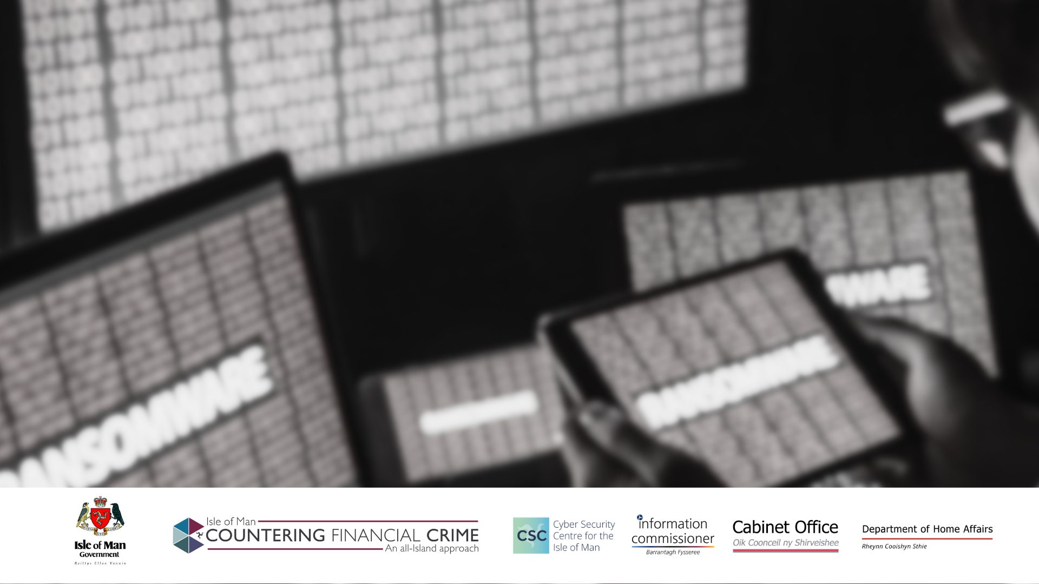
Cyber-Crime
Ransomware
& Sanctions
Alan Chambers, CISSP, MSyI, MCIIS

Slide 44

Introduction
What is Cybercrime?
Illegal activities conducted via the internet or other digital means.
Examples:
Hacking, identity theft, phishing, and ransomware attacks.

Slide 45
What is Ransomware?
Definition: A type of malicious software designed to block access to a computer system until a sum of money is paid.
How it Works: Encrypts files and demands a ransom for the decryption key.
Common Ransomware Strains: Conti, Ryuk, Trickbot.

Slide 46




Risk to Businesses
Financial Loss: Costs associated with ransom payments, recovery, and downtime.
Data Breach: Loss of sensitive information.
Reputation Damage: Loss of customer trust and potential legal consequences.
Operational Disruption: Interruptions to business operations and services.

Slide 47
What is Denial of Service?
Definition: A type of malicious activity designed to disrupt access to a computer system until a sum of money is paid.
How it Works: overloading the system that allows the exchange of information between an external client and business systems usually by flooding them with traffic to the extent they slow down or fll over.

Slide 48



Case Studies
Example 1:
Attack on the Irish Health Service Executive (HSE)
Example 2:
Costa Rican Government Ransomware Attack

Slide 49
Attack on the Irish HSE
Date: 14th May, 2021
Attackers: Conti ransomware group

Slide 50



Attack on the HSE (2)
Impact:
  Total shutdown of HSE IT systems across Ireland
  Disruption of hospital services and appointment cancellations
  Data breaches involving medical and employee records
  Significant operational and financial impact on the healthcare system
Response:
  HSE took down IT systems to protect data
  Recovery involved extensive technical and operational efforts
  Demonstrated the need for improved cybersecurity measures and preparedness.

Slide 51
Costa Rican Government Attack
Date: April 17, 2022
Attackers: Conti ransomware group, followed by Hive ransomware group

Slide 52
Costa Rican Government attack (2)
Impact:
  Nearly 30 government institutions affected, including the Ministry of Finance and Social Security Fund
  Disruption of tax and customs systems, healthcare services, and other critical operations
  Estimated losses of $30 million per day due to operational disruptions
  Declaration of a national emergency by the Costa Rican government

Slide 53
Costa Rican Government attack (3)
Response:
  International assistance from the US, Israel, Spain, and Microsoft
  Implementation of emergency measures to restore services and enhance cybersecurity
  Ongoing efforts to address vulnerabilities and prevent future attacks.

Slide 54

Incidents closer to home
Cayman National Bank
STRIX
Heron & Brearley / SPAR
Hospitality
Finance Sector
Insurance Sector
Legal Sector
Public Sector (local authority)
Charities
Basically, anyone can be at risk of becoming a victim

Slide 55
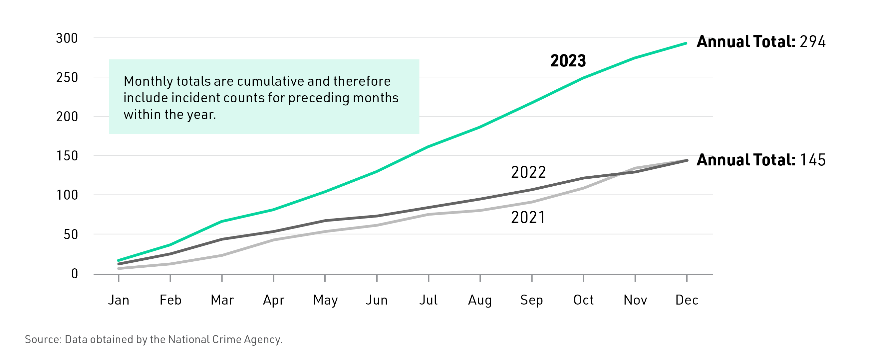
Exploring the Evolving Tactics of Cyber Criminals
Sophistication of ransomware deployment techniques
Cyber criminals continually develop advanced tactics for deploying ransomware, leveraging encryption and social engineering to maximise impact.
Emergence of double extortion strategies
Double extortion tactics, where cyber criminals threaten to leak sensitive data in addition to encrypting it, have become increasingly prevalent in ransomware attacks.
Adaptation to security measures and law enforcement responses.
Criminals adapt to defensive measures and law enforcement responses, posing ongoing challenges to cyber-security professionals and authorities.
Exploitation of global events and vulnerabilities
Cyber criminals exploit global events and vulnerabilities such as the COVID-19 pandemic and the Crowdstrike outage, to launch targeted ransomware campaigns with heightened success rates.

Slide 56
A Significant Increase in Ransomware Incidents

Slide 57

Global Efforts and Sanctions Against Ransomware
International Law Enforcement Collaboration
Global law enforcement agencies collaborate to combat ransomware, sharing intelligence and resources to identify and apprehend cyber criminals involved in ransomware activities
Economic Sanctions and Diplomatic Measures
Countries impose economic sanctions and diplomatic measures on nations or entities found to support or harbour ransomware operators, aiming to disrupt their infrastructure and funding sources.
Public-Private Partnerships and Cyber-Security Initiatives
Public and private sector partnerships develop cyber-security initiatives to strengthen defence capabilities, enhance incident response, and mitigate the impact of ransomware attacks.

Slide 58



Sanctions Against Cyber Criminals
Legal Sanctions
Countries impose legal sanctions such as fines, imprisonment and restrictions on cybercriminals involved in ransomware and cyberattacks.
Economic Penalties
Governments and international bodies impose economic sanctions on entities, blocking access to financial systems and assets.
International
Co-operation
Global organisations collaborate to impose sanctions on state-sponsored cybercrime groups and criminal networks.

Slide 59

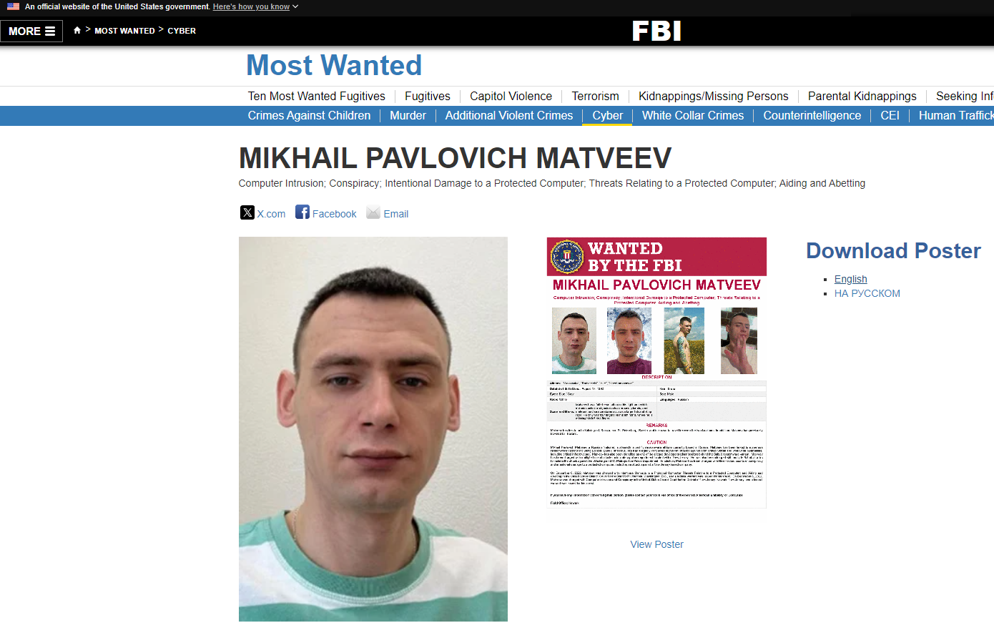

Slide 60
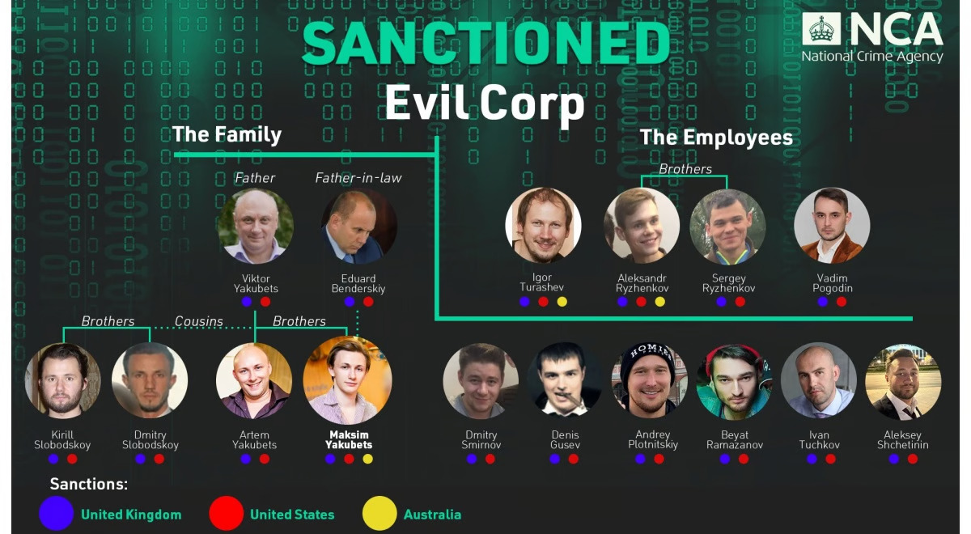

Slide 61
Legal Implications of Paying a Ransom
Paying a ransom to a designated person (DP) who is under international sanctions can have serious legal implications.
Criminal Offence: Making payments to individuals or entities under sanctions is generally prohibited and can be considered a criminal offence.
Civil and Criminal Penalties: Violating financial sanctions can result in severe penalties, including hefty fines and imprisonment.
Regulatory Scrutiny: Organisations that make such payments may come under intense scrutiny from regulatory bodies.
Reputational Damage: Beyond legal consequences, paying a ransom to a sanctioned entity can severely damage an organisation’s reputation, leading to a loss of customer trust and potential business losses.

Slide 62



Legal Implications of Paying a Ransom (2)
Mitigating Factors: Regulatory bodies may consider mitigating factors, such as whether the organisation took steps to avoid the payment or reported the incident promptly.
However, these factors do not guarantee leniency.
It’s crucial for organisations to consult legal experts and follow regulatory guidelines when dealing with ransomware attacks to avoid breaching international sanctions.
Cybersecurity Measures
Regular updates, backups, and employee training.
Incident Response Plan
Steps to take in the event of a ransomware attack.
Legal
Consultation
Importance of consulting legal experts before making ransom payments.

Slide 63
Mitigation Strategies
Cybersecurity Measures
Regular updates, backups, and employee training.
Incident Response Plan
Steps to take in the event of a ransomware attack.
Legal
Consultation
Importance of consulting legal experts before considering ransom demands

Slide 64
Preventative Measures Against Ransomware
Regular Software Updates
Ensure all software and systems are up to date with the latest security patches.
Data Backups
Regularly back up data and store it offline or in a secure cloud service.
Employee Training
Educate employees about phishing attacks and safe online practices.
Use of Antivirus and Anti-Malware
Install and regularly update antivirus and anti-malware software.

Slide 65
Preventative Measures Against Ransomware (2)
Network Segmentation
Divide the network into segments to limit the spread of ransomware
Access Controls
Implement strict access controls and use multi-factor authentication (MFA).
Incident Response Plan
Develop and regularly update an incident response plan.

Slide 66
Developing Effective Ransomware Prevention Strategies
Ransomware attack vectors and vulnerabilities
Analysing the methods used by cyber criminals to infiltrate systems and exploit weaknesses for ransomware deployment.
Best practices for ransomware mitigation
Exploring proactive measures such as regular data backups, network segmentation, and employee training to prevent ransomware attacks.
Impact of ransomware on critical infrastructure
Assessing the potential consequences of ransomware targeting essential services and infrastructure, including healthcare and utilities.
Collaborative approaches to ransomware response
Examining the importance of public-private partnerships and information sharing in responding to ransomware incidents.

Slide 67
Examining the psychological impact on targeted individuals and organisations
Psychological trauma and stress on ransomware victims
Ransomware victims experience psychological trauma and stress, stemming from the violation of privacy and potential exposure of sensitive information.
Reputational damage and trust issues for affected entities
Entities targeted by ransomware face reputational damage and trust issues
Mental health effects on employee and personnel
Ransomware incidents can lead to mental health effects on employees and p[personnel, necessitating support and resources for coping with the aftermath.
Psychosocial impact on communities and broader society
Ransomware events have a psychosocial impact on communities and society at large, influencing perceptions of digital security and privacy.

Slide 68
Challenges and Future Outlook
Challenges in Cybercrime
Law enforcement faces difficulties due to the anonymous and borderless nature of cybercrime, alongside constantly evolving tactics by cybercriminals.
Future Trends
Predicted increase in ransomware-as-a-service (RaaS), Ai-enhanced cyberattacks, and more sophisticated cybersecurity technologies.
Innovation in Defence
Advances in AI and machine learning are expected to improve cybersecurity, helping to detect and counteract cyber threats more effectively.

Slide 69
Conclusion
Seek professional help to minimise the damage and impact
Do not pay ransom under any circumstances

Slide 70
Q & A
Cyber@gov.im 685557
Threat Report & Advice https://csc.gov.im
Suspicious emails sers@gov.im

Slide 71
Challenges and Future Outlook
Challenges in Cybercrime: Law enforcement faces difficulties due to the anonymous and borderless nature of cybercrime, alongside constantly evolving tactics by cybercriminals.
Future Trends: Predicted increase in ransomware-as-a-service (RaaS), Ai-enhanced cyberattacks, and more sophisticated cybersecurity technologies.
Innovation in Defence: Advances in AI and machine learning are expected to improve cybersecurity, helping to detect and counteract cyber threats more effectively.

Slide 72
Closing Remarks
Notes:
GSC urges all compliance professionals to consider cybercrime risk posed to your business and put in place policies for dealing with attacks before they occur.

Slide 73
Where to find us…
YouTube Channel - youtube.com/@IOMGSC
LinkedIn
  /company/isle-of-man-gambling-supervision-commission
Newsletter Sign-up Form
  https://dashboard.mailerlite.com/forms/1118744/133525586866865391/share
Newsletter
Sign-up Form
Countering Financial Crime LinkedIn page
  /company/isle-of-man-countering-financial-crime
Notes:
Also just a quick reminder on where to find us!

