Slide 1


25th GSC AML Forum

Slide 2

Welcome
25th GSC AML Forum
July 2026

Slide 3
Agenda
25th AML Forum
GSC Update | An introduction and update on the GSC
Guest Speaker | Targeted Financial Sanctions
SARs | Mini SARs Workshop
Break | 15-minute comfort break
VA | Virtual Assets
Outreach | Outreach Update
Guest Speaker | Interview Preparation Feedback
Q&A | Q&A Session

Slide 4
GSC Update & Welcome

Slide 5
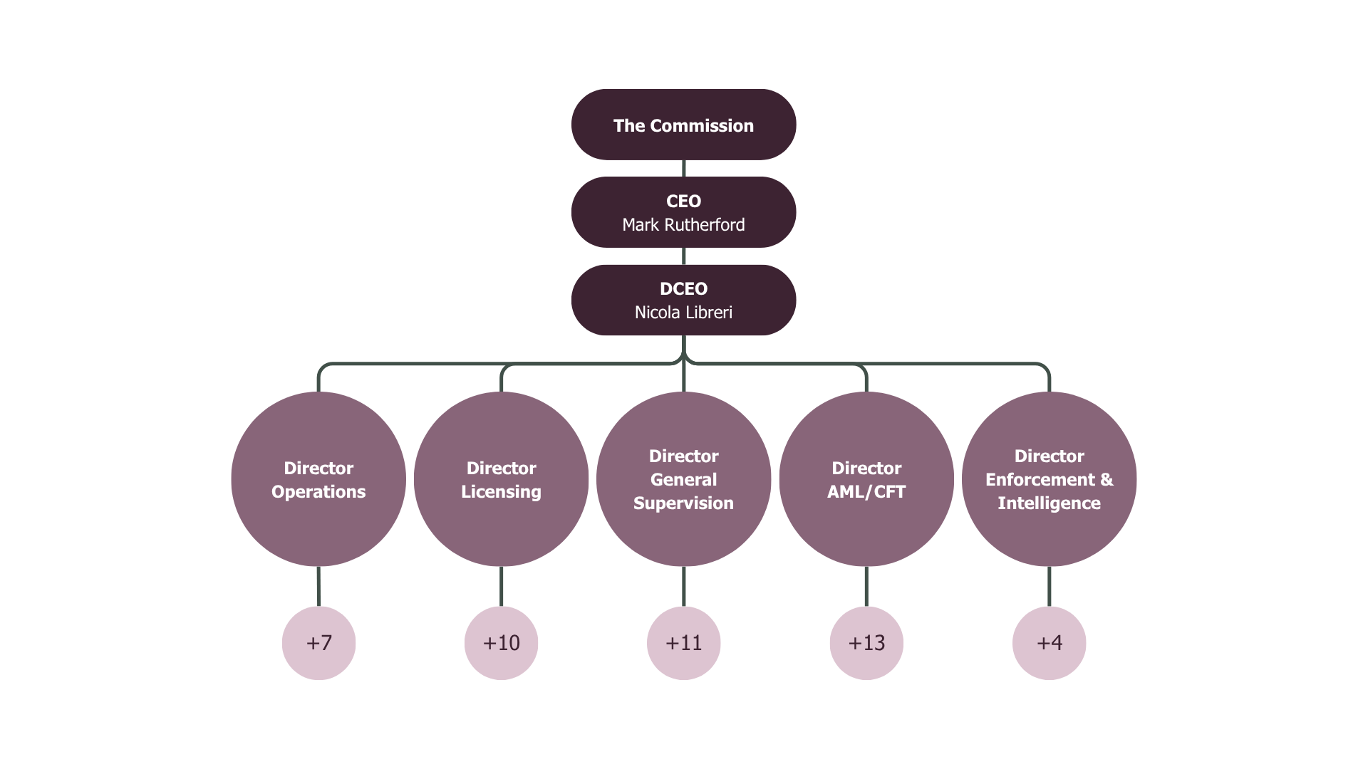
GSC Update:

Slide 6


GSC Bill
Where are we up to?
Consultation closed – Thank you to all who participated
Feedback collated, actioned.
Currently with AGs
Hoping it’ll be passed for royal ascent before summer break
Notes:
https://www.isleofmangsc.com/gambling/gsc-gambling-news/08-july-2026-civil-penalties-guidance-stakeholder-engagement-feedback-response/

Slide 7
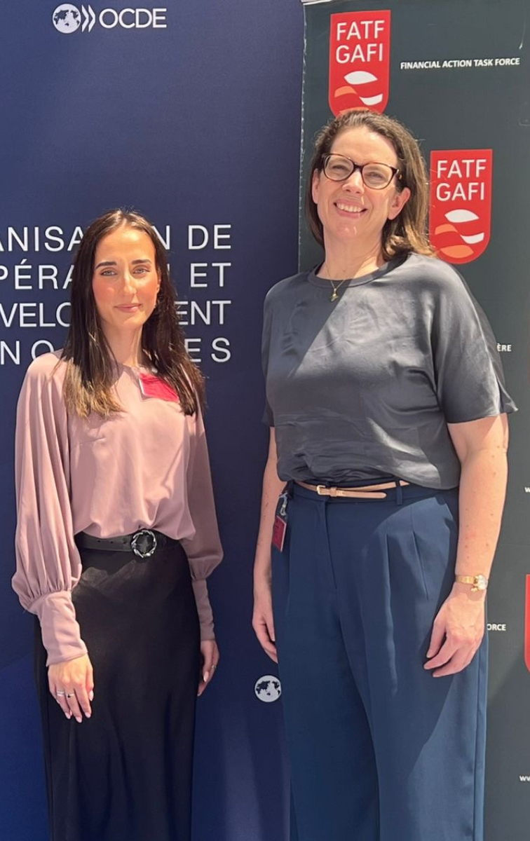
FATF Adopt Report
FATF recently adopted a report on the Risks of Gaming & Gambling, co-led by the Isle of Man and Australia.
Alivija introduced the project to the Risk, Trends and Methods Group on behalf of the co-leading jurisdictions and the project team.
The FATF approved work to update the global understanding of risks in these sectors with illicit finance risk indicators that will help to detect criminal activity in these industries
Notes:
.

Slide 8
Mutual Evaluation Process

Slide 9
MONEYVAL Update:
Key milestones:
  Risk and context presentation
  Scoping note – online gambling area of increased focus; land-based casino area of decreased focus
  Submission of TCQ, MEQ, data and statistics, case studies, supporting documents
  Briefings to private sector
  Interview Prep
  Long-list of operators put forward to MV by supervisors
What’s to come?
Drafted initial findings expected in August
Private sector meetings tbc around mid-August – further comms when we know more
More MONEYVAL prep engagement to come – briefing to long listed firms 6th August
On-site is 28th Sept – 9th Oct 2026 – long listed firms should ensure key personnel are available over these dates
Expect minimal comms on MV until evaluation published as per MONEYVAL’s Rules of Procedure.

Slide 10
Date | Activity
Winter 2025/Spring 2026 | Publication of suite of National Risk Assessments
March 2026 | Technical Compliance Questionnaire submitted to MONEYVAL
March and April 2026 | Briefing sessions for industry
April 2026 | Interview preparation
June 2026 | Proposed long list of firms to be interviewed submitted to MONEYVAL
June 2026 | Effectiveness Questionnaire submitted to MONEYVAL
6th August 2026 | Briefing sessions for long listed firms
Mid-August 2026 | Onsite programme finalised by MONEYVAL and selected firms are notified
September/October 2026 | Onsite mutual evaluation
December - March | Draft Mutual Evaluation Report received December 2026 followed by various opportunities for IOM Government to provide comments/clarifications and discuss with the Assessment team face to face in March 2027. Report CONFIDENTIAL through this period.
May 2027 | MONEYVAL Plenary – Report is adopted – CONFIDENTIAL until publication
May 2027/June 2027 | Following the Plenary, unless there is further FATF Global Network quality and consistency review, Report is published, around 6 weeks after adoption.

Slide 11


Targeted Financial Sanctions

Slide 12
Who we are
Legislation
Guidance
Outreach
Licences
Enforcement
Implement UN & UK Sanctions regimes
Designations effective immediately
Notes:
My name is Helena Watterson, and I am the Sanctions Officer in the Isle of Man Government, working within the Customs and Immigration Division which is part of the Treasury Department. We are the competent authority responsible for implementing and enforcing sanctions in the Island
The Isle of Man implements all United Nations and United Kingdom sanctions regimes
Our role is to ensure those measures are understood, applied correctly, and embedded effectively across industry. We provide guidance and support, promote strong compliance, and work closely with partners to identify and respond to sanctions risks and evasion.

Slide 13
Sanctions Legislation reminder
Terrorism and Other Crime (Financial Restrictions) Act 2014 (“TOCFRA”)
Sanctions Act 2024 (together with Sanctions (Implementation of UK Sanctions) Regulations 2024)
UN sanctions regimes for TF and PF (including ISIL, DPRK, Iran)
Asset freeze on UN designated persons
UK autonomous sanctions regimes and other UN regimes (e.g. Russia)
Asset freeze, travel bans, trade and transport sanctions
UN Sanctions List updates apply immediately upon UN decision
These form part of the “AML/CFT legislation” definition in the Gambling Code
Notes:
The Domestic Sanctions legal framework is set out in 2 Acts – the Terrorism and Other Crime (Financial Restrictions) Act 2014 and the Sanctions Act 2024.
These Acts provide for the UN and UK asset freeze requirements, trade restrictions, travel bans and transport sanctions
TOCFRA is also where the power for the Isle of Man Treasury to designate a person in relation to terrorism lies.
Where Sanctions Lists are updated by the UN or UK they have immediate effect in the Island – and the obligations to freeze assets of those designated also apply immediately.

Slide 14
“Sanctions Lists”
UN Sanctions List
UK Sanctions List
TF and PF (i.e. ISIL, Taliban, DPRK, Iran)
UK autonomous sanctions regimes and other UN regimes (e.g. Russia, Cyber, Belarus)
Changes apply immediately upon UN decision
Updates apply immediately
Isle of Man Sanctions List
IOM designations relating to involvement in terrorist activity
No-one currently designated on this list
Keep up to date:
Sign up to UN mailing list
Sign up to receive news from Customs via RSS feed

Slide 15
Why Sanctions Matter
Finance System Integrity
Industry plays a critical front-line role
Peace & Security
Prevention of Terrorist & Proliferation Financing

Slide 16
Asset Freeze - Core Principle
Do not deal with Funds or Economic Resources belonging to a Designated Person
Do not make them available to, or for the benefit of, a Designated Person
Identify
Prevent
Indirect Risk
Sanctions lists must be checked regularly

Slide 17
Verify
Stop
Report
Exemption or Licence?
Actions
Freeze
Delays can result in a breach

Slide 18
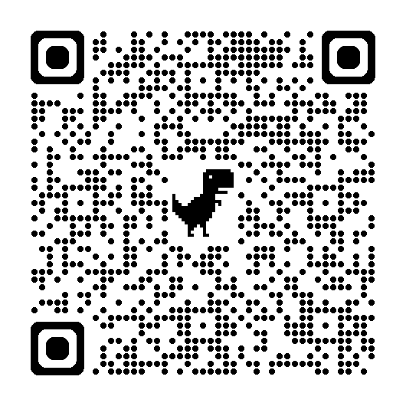
Reporting Obligations
Frozen Assets
Suspected Breaches
Attempted transactions
Report to FIU
Mandatory Reporting

Slide 19
Top 10 Sanctions Compliance tips
Buy-in
Procedures
Horizon scanning
Screening
Tools
Risk
Support
Record Keeping
Training
Audit

Slide 20
Sanctions Licences
Licences allow someone to deal with frozen assets
Only permitted for certain activity
Basic needs
Prior obligations
Review General Licences that may apply/
Apply for individual licence to Sanctions Officer at C&I
May need to apply to other jurisdictions where there is a nexus
Certain legal fees
Routine holding/maintenance

Slide 21
National Risk Assessment:
Sanctions Risks and Typologies
National Risk Assessments
Terrorist Financing NRA
Proliferation Financing NRA
Legal Persons and arrangement NRA
Virtual Assets NRA
Money Laundering NRA

Slide 22
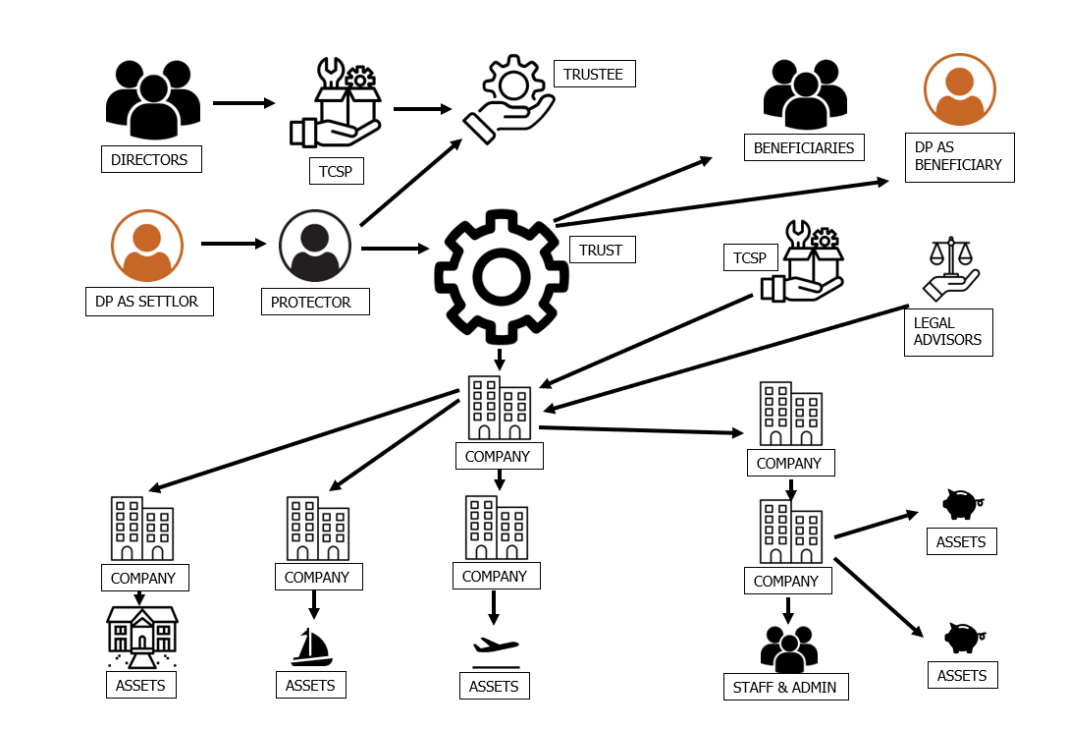

Slide 23
VASP A (Exchange)
Wallet Cluster A
Offshore Shell Company
Mining Pool/Mixer (Obfuscation Layer)
Customer
VASP B (Custodian)
Wallet Cluster B
Layered Fund
Cross-Chain Bridge
VASP C (DEX)
Wallet Cluster C
Sanctioned Entity

Slide 24
A.I.
Deepfake
Conceal Identity
False described goods
Intermediaries
Hidden final destination
Routing transactions through 3rd countries

Slide 25
Terrorist Financing NRA
Proliferation Financing NRA
Legal Persons and Arrangements NRA
Virtual Assets NRA

Slide 26
Key Industry Takeaways
Risks are dynamic and evolving
Have a strong understanding of your exposure
Controls need to be tested not just documented

Slide 27
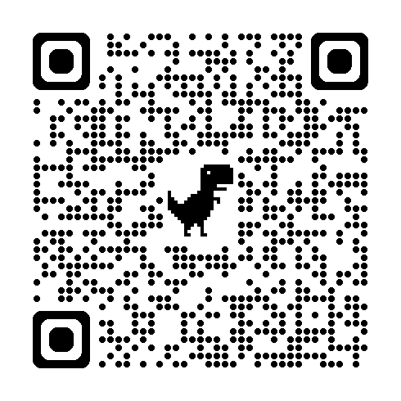

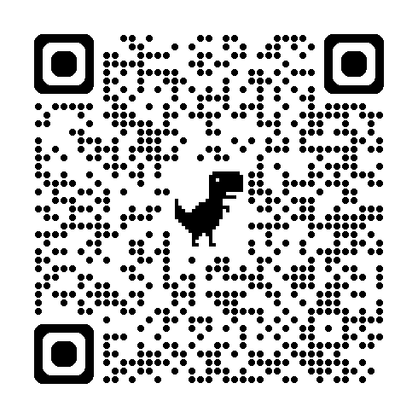
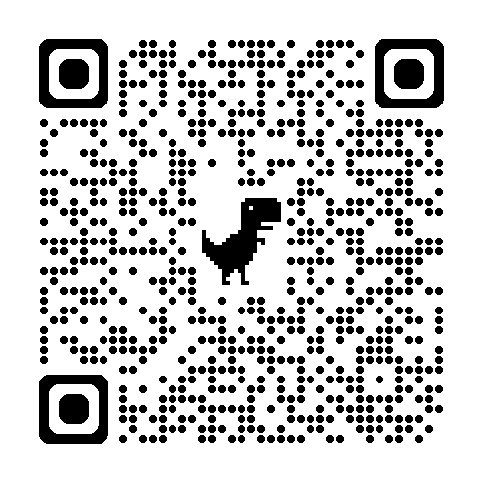
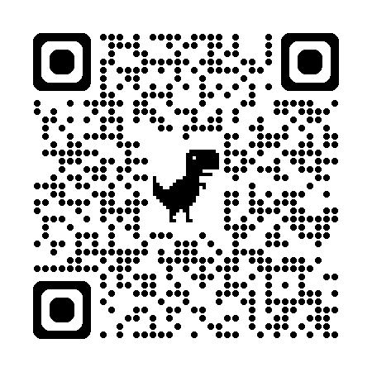
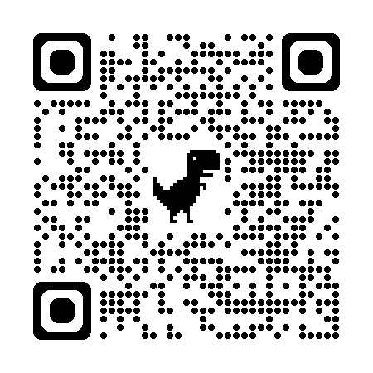
Tools and Resources
Sanctions Risk
Assessment tool
Licencing
Information
Reporting
Guidance
Sanctions Lists
National Risk
Assessments

Slide 28

Contact Details
Thank you
Any Questions?
Sanctions@gov.im
01624 648109

Slide 29
Suspicious and Unusual Activity Reporting
AML/CFT Inspections Team
Tommy Corlett & Matthew Cregeen

Slide 30

GSC Legislation
Legislation around Suspicious Activity Reporting
MLRO / Nominated AML/CFT Officer responsibilities
SARs – Things to consider
Latest SAR statistics
Examples of B2B disclosures
How to find further information

Slide 31
Legislation and Types of Disclosure
Proceeds of Crime Act 2008 (POCA)
Anti-Terrorism and Crime Act 2003 (ATCA)
Financial Intelligence Unit Act 2016 (FIU Act)
Sanctions Act 2024
Terrorism and Other Crime (Financial Restrictions) Act 2014 (TOCFRA)

Slide 32

MLRO / Nominated Officer Expectations
Handling of suspicious activity reports
Maintaining registers – internal/external/other/enquiries
Contribution to board reporting and training
Seniority and expertise
Right of access
Sufficient time and resource
No commercial conflict
Themis access
Introductory interview
Opportunity for a discussion on exit

Slide 33

SARS – Things to Consider
Report as soon as reasonably practicable
Have a contingency
Document your decision-making process
Don’t report for the sake of doing so
Ensure procedures and practical approach are aligned
Keep registers accurate and up to date
Don’t overwrite internal SARs in the register when they have been externalised
Determine whether consent should be requested
Be cautious of tipping off

Slide 34


SAR Statistics
2025 Statistics
FIU received 1,627 disclosures
Decreased by 9.31% from 2024
Banking the biggest reporter
E-Gaming sector decreased by more than half in 2025.
The predominant ground for suspicion were internet/media research (48%), automated/internal triggers (16%) and KYC issues (14%).
INVESTMENTS
TCSPS
EGAMING
LIFE ASSURANCE
VIRTUAL CURRENCIES
BANKING

Slide 35
SUSPICIOUS ACTIVITY REPORTS
ONLINE
Total Figures
Year | Internal | External
2023 | 651 | 99
2024 | 275 | 62
2025 | 485 | 61
B2C Figures
Year | Internal | External
2023 | 651 | 97
2024 | 275 | 60
2025 | 470 | 52
B2B Figures
Year | Internal | External
2023 | 0 | 0
2024 | 0 | 2
2025 | 15 | 9

Slide 36
Case Study – TM Solutions Ltd & DT Interactive Holdings Ltd
The case study features
B2B AML Risks
Ongoing monitoring
Beneficial Ownership
Source of funds
Governance & Escalation
Regulatory Expectations
TM Solutions Ltd
Business Model
B2B only
No retail players
No player funds held
Services
Platform software
Tech support
Gaming aggregation
DT Interactive Holdings Ltd
During onboarding:
B2C licenced Operator
Target market is Latin America
Product is sportsbook

Slide 37
Onboarding…
Ownership includes several corporate shareholders
Certain shareholders are based overseas
Some verification documents take longer than expected to obtain
Investment funding has recently been introduced to support expansion
At this stage, all information provided appears broadly consistent with the customer’s risk profile.

Slide 38
After 6 months …
DT becomes one of TM’s fastest-growing customers
Revenue generated exceeds expectations
Additional products and services are requested
The relationship is considered commercially significant
At this stage, no significant compliance concerns have been escalated
During a routine review:
One invoice in settled by a parent company rather than the contracted entity
The customer advises this reflects a group treasury arrangement
Supporting documentation is requested and subsequently provided
While explainable, Compliance notes the arrangement for future monitoring

Slide 39
After 1 year …
During the first year of the relationship:
A minority investor acquires a stake in the business
Two directors are appointed as part of an expansion programme
The group structure becomes slightly more complex
The changes appear commercially reasonable but require updated due diligence.
When updated information is requested:
There are delays in obtaining certified documentation
Some information originates from overseas advisors
Follow-up requests are required before all documentation is received
The customer ultimately cooperates, although the process takes longer than anticipated
As the business grows:
Additional funding is injected by investors
Documentation broadly supports the funding arrangements
Some aspects of the investment structure require clarification
Compliance seeks additional comfort regarding the source of investment funds

Slide 40
Periodic screening …
A minority shareholder previously held interests in businesses that attracted regulatory attention.
No enforcement action was taken against the individual
No evidence of criminal conduct is identified
The information does not fundamentally alter the relationship but contributes to the overall risk assessment.

Slide 41
Emerging Risk Profile …
Individually, none of the following issues are considered significant:
Slightly complex ownership structure
Overseas investors
Delays in obtaining documentation
Group payment arrangements
Historical adverse media
However, taken together they raise questions regarding:
Whether the current risk rating remains appropriate?
Whether enhanced due diligence is warranted?
Whether additional monitoring should be introduced?

Slide 42
Commercially important …
DT has become an important customer
The business wishes to:
Expand the relationship
Launch additional products
Accelerate implementation timelines
Compliance and commercial teams must ensure that growth does not outpace risk assessment activity.

Slide 43
Escalation…
Compliance prepares a comprehensive risk review
Key findings include:
Increased ownership complexity
Unresolved source of funds questions
Unexplained third-party payments
Growing difficulty obtaining information
Adverse intelligence findings
The matter is escalated to:
MLRO
Senior Management
Risk Committee

Slide 44
Enhanced Due Diligence
Outcome 1
Additional information is obtained and concerns are satisfactory addressed.
Relationship continues with enhanced monitoring
TM initiates
Enhanced Due Diligence
Independent ownership verification
Additional source of funds enquires
Enhanced screening activities
Review of all payment arrangements
Governance Measures
Senior Management oversight
Increased monitoring
Formal risk assessment
Outcome 2
Information gaps remain unresolved
Risk level continues to increase
Outcome 3
Further enquires identify material inconsistencies and significant financial crime concerns.
Relationship termination becomes a consideration

Slide 45
How to find further information
GSC website
  Legislation
  Guidance Notes
  Historic AML Outreach materials
FIU Online Gambling Typologies Report

Slide 46
-
-BREAK-

Slide 47
Virtual Assets

Slide 48

Virtual Asset NRA
The overall ML risk relating to VAs and VASPs in the IOM is assessed as Medium.
TF and PF risks are assessed as Very Low for both.

Slide 49
Virtual Asset NRA - Threats
Money Laundering Threats
Cyber enabled fraud
Exploitation of VA by organised crime groups
Increasing use of stablecoins (USDT)

Slide 50
IOM Constabulary Annual Report
The Constabulary identified and blocked USDT 6.2 million in suspected illicit funds as part of ongoing investigations
Intelligence reports involving VAs increased from 7 in 2019 to 41 in 2025 (+486%), while active investigations increased from two to 27 by 2024 (+1250%).
Across active investigations approximately £324 million has been restrained, with £318 million believed to originate from VAs
Notes:
Source: “As part of ongoing investigations, the IOMC has identified and blocked USDT 6,299,329 in suspected illicit funds on‑chain, with work ongoing alongside chain providers to realise these assets. This activity reflects the increasing prominence of cryptocurrency in serious and organised crime. The scale and complexity of cryptocurrency‑enabled offending has continued to increase. Intelligence reports involving crypto rose from seven in 2019 to 41 in 2025 (+486%), while active investigations increased from two to 27 by 2024 (+1250%). During the year, the PIMLIT submitted 134 international requests relating to cryptocurrency enquiries. Across active investigations, approximately £324 million has been restrained, with £318 million believed to originate from cryptocurrency. These figures illustrate the growing threat posed by digital assets and the necessity of sustained specialist capability. Investment in eDiscovery and AI-enabled analytical tools has improved efficiency and reduced manual workloads, with 32.2TB of digital material processed during the year.“ https://www.tynwald.org.im/spfile?file=/business/opqp/sittings/20212026/2026-GD-0010.pdf

Slide 51
Virtual Asset NRA - Threats
Terrorist Financing Threats
Crowdfunding and social media platforms
Use of unregistered VASPs
Exploitation of anonymity tools

Slide 52
Virtual Asset NRA - Threats
Proliferation Financing Threats
DPRK cyber attacks and VA theft
Iran’s use of mining to evade sanctions
Use of VA for revenue-raising by sanctioned actors

Slide 53
Virtual Asset NRA
Emerging Risks
Rapid global adoption of stablecoins, especially USDT as a layering tool
Technological developments and increased use of mixers, tumblers, and anonymisers
Growth in global VA‑related underground banking
Increased interconnection between traditional sectors and VAs (indirect exposure)

Slide 54


The Royal United Services Institute for Defence and Security
“
”
Over the last six years, virtual assets have played a significant role in PF and sanctions evasion.
Algorithms of Evasion: The Rise of AI-Enabled Proliferation Financing – RUSI (May 2026)
Notes:
https://static.rusi.org/algorithms-of-evasion-rp-may-2026.pdf

Slide 55

Virtual Asset NRA
GSC Observations
Negative OSINT
Lack of rationale
Complex / large structure
Jurisdictional exposure to high-risk countries
Increase in B2B operators utilising VAs for payment settlement to / from suppliers and clients
Network Partners and B2B clients increasingly offering VAs as a payment options to their own customers

Slide 56
Virtual Asset NRA
Potential Risk Indicators
Unexplained SOW originating from VA activity
VA derived wealth inconsistent with customer profile
Use of VAs for commercial transactions without reasonable rationale
Routing payments through multiple VASPs or other intermediaries
Complex corporate structures

Slide 57
Virtual Asset NRA
VASPs, gaming operators, FIs and DNFBPs should:
Integrate findings from the VA and VASP risk assessment into BRA, CRA, and TRA.
Assess their own VA‑related exposures, including indirect exposures.
Consider interdependencies with other NRAs
Maintain vigilance over:
  VA‑enabled fraud
  Cybercrime targeting customers
  PF/TF emergence (especially in decentralised ecosystems)
Continue to engage with regulators and the IOMFCP.

Slide 58


Key Takeaways
Effective risk assessments
Due Diligence
Sanctions
Assess your VA-related exposure
Ensure findings from the VA and VASP NRA are integrated into your BRA, CRA and TRA
Ensure your policies and procedures remain effective in light of the VA and VASP NRA
Ensure EDD proportionate to BRA risk
Virtual Assets increasingly used for TF/PF and sanctions evasion

Slide 59
Outreach

Slide 60

What have we been up to?
Outreach & Guidance following feedback
NRA Outreach
GSC guidance update
Consultations and surveys
Collaboration
Improved inter-agency data sharing
Working with industry

Slide 61

What is coming up?
Collaboration
IOM CFCC
More collaboration on typology information with partner agencies
More comms
Comms on MV – those on longlist contacted.
More video content on key typologies, and on BRA/TRA/CRAs
Hoping to do more live webinars

Slide 62
Outreach Survey

Slide 63
Interview Preparation Feedback
& MONEYVAL Update

Slide 64
Overall Assessment
A strong position
Good explanation of risk
Clear mitigation presented
Some differences between firms but no significant concerns

Slide 65
Real Examples
Handling of Complexity
Understanding of Risk
Supervision and Partnership
Proportionate Approaches
Consistent National Picture
What worked well

Slide 66
Specific Feedback
Beneficial Ownership
Your BRA, CRA, TRA
TF and PF
Explain what you already do
Sector and National Risk Assessments
Sanctions

Slide 67
General MONEYVAL Update and any questions
Effectiveness Submissions
Risk Appetite Statement and National Action Plan
Countering Financial Crime Conference 12 August

Slide 68
Q&A Session

