Slide 1


24th GSC AML Forum

Slide 2

Welcome
24th GSC AML Forum
January 2026

Slide 3
Agenda
24th AML Forum
GSC Update | An introduction and update on the GSC
NRA Update | Update on the Gambling - Money Laundering Assessment
Break | 15-minute comfort break
Outreach Update & Survey | Feedback Survey and Update on GSC Outreach
TF NRA Key Takeaways | Terrorist Financing NRA – Summary and Key Takeaways
Q&A | Q&A Session

Slide 4
GSC Update & Welcome

Slide 5

GSC Update: Good News
NRA read & adopted well by industry
SARs
Good quality SARs from our industry
Terrestrial SARs are up in 2025 on 2024
Effective cooperation
STRIX noted lots of information exchange packages
PPP – will talk more on this later!
Between us, FSA etc., there have been a lot of requests from regulators recently and we understand & want to say thank you!
Network Guidance released last year
We’ve been sharing NRA findings & typologies
Adapting to a lot of change in tricky times. Industry has our (and wider gov) full support!

Slide 6

GSC Bill
Next set of feedback published
Another round of feedback from Treasury was received and changes made and a summary of that feedback has been published on the GSC blog.
Currently in the clauses stage of the House of Keys, which is expected to conclude on 03 February 2026.
Expected to enter the Legislative Council on 24 February 2026.
Thanks again to everyone who has provided feedback on the draft legislative changes.
GSC will do more Outreach on the Bill as it progresses.
Notes:
Should you have any further questions, please contact the GSC via the contact form on our website or contact Mark Rutherford directly via email at mark.rutherford@gov.im.

Slide 7

Financial Crime Partnership
Chaired by the FIU
Representatives from various IOMG agencies as well as industry
Consists of a steering group and 4 subgroups
Banking
Projects include HT/Modern slavery and Money Mule
Insurance
Project on complex structures underway
TCSP
Project on Limited Services Risk
EGaming Risk
Formed in August 2025 – Projects TBC (initial discussions so far)
“Collaboration between industry, government agencies and regulators is critical to maintaining the Island’s reputation as a well-regulated international finance sector and an outstanding place to do business.” - Jane Poole-Wilson MHK

Slide 8

GSC Risk Review
2025 detailed file reviews – prioritised by ownership & control geography
Response to global OCG threat – typologies, red flags, trends
Ongoing and close collaboration with other agencies
Alongside NRA work
Treatment of any high risk issues
Internal observations and recommended improvements
Outreach and engagement – increase risk understanding and mitigations
Industry collaboration

Slide 9
Mutual Evaluation Process

Slide 10

Country Training
Monday 26th
Open to both public and private focused on deepening understanding of the mutual evaluation framework and supporting strong implementation of international AML/CFT standards.
Tuesday 27th
A mock on-site session with two highly experienced members of the MONEYVAL secretariat.
Feedback from Secretariat positive – industry very engaged. Government contributions (presentations and interviews) informed and comprehensive, in many cases supported by evidence.

Slide 11

Mutual Evaluation process
Stage of ME process | Timing (as per MV 6th round procedures) (TBC)
Pre‑evaluation preparations Sending data, case studies Mock Evaluation (Country Training) Preparing for visit | 6–12 months before on‑site
On‑site visit | 8–12 days / Autumn 2026
Post on‑site drafting Drafts shared between IOM and AT Face-to-face discussions between IOM and AT | 3–4 months
Working Group & Plenary review | Next plenary session
Adoption of MER & Roadmap | 6–9 months after on‑site Publication summer 2027 (tbc) Supported by press materials and programme of outreach
Follow‑up (regular or enhanced) | Ongoing Regular follow-up Enhanced follow-up ICRG IOM was in enhanced follow up after last round. For context, by the end of 2023, 20 of the 33 states and territories evaluated by MONEYVAL in the 5th round of mutual evaluations were subject to its enhanced follow-up.
Monday 26th
Open

Slide 12
Industry involvement
Participation in the on-site visit, meeting with Financial institutions; DNFBPs; Industry associations
Contribution to data and effectiveness evidence, largely indirectly through supervisory returns and findings / case studies
Everyone has a role to play!
Mock evaluation; awareness sessions; readiness workshops; training on the methodology – welcome input from industry as to what they would like to be best prepared
Sources of evidence of effectiveness
Private‑sector entities may be contacted again during follow‑up requests; clarification rounds during MER drafting; supplemental evidence provision.

Slide 13
How is IOMG preparing?
External Experts
Mock Interviews (positive feedback here already!)
Input into TCQ and MEQ drafting.
Input into private sector engagement.
National Risk Assessment
Key part of AML framework
Multi-Agency Collaboration
Working Groups Dedicated IOMG Outreach & Comms Group
Data
Understanding our data better, improving data sharing. (SARs, Sanctions, PF Survey…)
Housekeeping
Reviewing processes and controls
Tabletops
Recent TF and Sanctions tabletops

Slide 14
-
-BREAK-

Slide 15
Gambling Risk Assessment

Slide 16
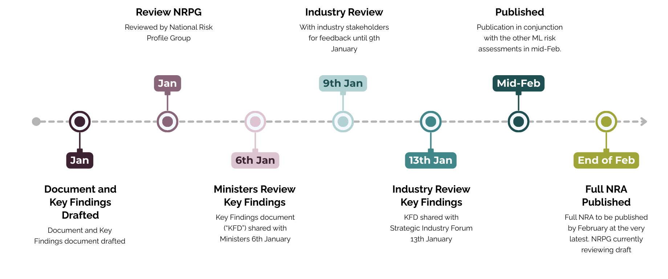
Gambling Risk Assessment
Notes:
.

Slide 17


Q`
The Revised NRA Framework
The framework is comprised of standalone topical and sectoral risk assessments, covering:
Terrorist Financing (TF)
Proliferation Financing (PF)
Non‑Profit Organisations (NPOs) – TF focus
Virtual Assets (VA) and Virtual Asset Service Providers (VASPs)
Legal Persons & Arrangements (LPA)
Sectoral RAs: Banking, Insurance, Gambling, Trust & Corporate Service Providers (TCSPs)
An overarching ML Risk Assessment summarises risk across all sectors.
Full NRA scheduled for publication February 2025.

Slide 18
How Sectoral RAs Feed into NRA
 | Sectoral | Contribution to National NRA
Threat Identification | The sources and methods through which ML or TF risks arise, typically linked to the underlying criminal activities that generate illicit proceeds. | Contributes to national threat landscape
Vulnerability Analysis | Weaknesses in a country’s systems, institutions, sectors, or controls that make it possible for threats to materialise. | Shapes national vulnerability profile
Controls Effectiveness | The defences, safeguards, and institutional mechanisms that prevent or reduce the likelihood of ML/TF | Informs national effectiveness assessment
Risk Scoring | Sectoral ML/TF risk ratings | Adjusted, weighted and aggregated for national risk levels
Cross‑Sector Linkages | Interactions with banking, TCSPs, use of VA etc. | Identifies systemic and emerging national risks

Slide 19
Q`
What’s Next?
NRA outreach
National Action Plan
Supervisory actions
Updated guidance embedding NRA findings into practice

Slide 20
Q`
Sector Background
Gambling is the largest non-financial sector in the Isle of Man, contributing 14.2% of national income in 2023/24.
The gambling sector is the largest non-financial sector in the Isle of Man, contributing 14.2% of national income in 2023/24.
The sector comprises both regulated online gambling operators and ancillary services that support the sector.
The GSC licenses, approves and supervises all forms of gambling activity carried out and hosted in the Isle of Man.

Slide 21
Sector Background
The online gambling sector, which is international in nature, accounts for most licence holders.
The majority of declared profit originates from software supplier businesses, which are currently outside international AML/CFT standards. The GSC has an elective software supply licensing regime, so some software supply business is licensed and subject to GSC supervision against licence conditions and targeted guidance. There is also a substantial un-regulated software supply sector.
There are a small number of terrestrial (land-based) operators consisting of one casino and a limited number of bookmakers.

Slide 22


Risk Ratings
The Gambling sector overall is assessed as medium-high risk for money laundering.
The online gambling sector has a medium-high risk, reflecting a large number of international customers and transaction volumes.
The terrestrial gambling has a medium-low risk, reflecting its smaller size, domestic profile and lower transaction volumes.

Slide 23
Threats
Core Threats Include
Core threats include:
Criminal ownership and control of gambling businesses or software suppliers, via front companies and complex corporate structures.
Exploitation by organised crime groups, including those from East and Southeast Asia, for money laundering, cyber-enabled crime, and other illicit activities globally.
Criminals using false or stolen IDs, synthetic identities, and mule identities to access gambling services and obscure their true identity to bypass due diligence controls.
For terrestrial gambling, cash-intensive operations and casino-specific instruments remain primary channels for laundering domestic predicate offences.

Slide 24


Emerging Risks Globally
Emerging Technologies
Turnkey Solutions
Use of advanced technologies (AI, deepfakes, virtual assets) to obscure identities, automate fraud, and facilitate cross-border transfers.
Use of “turnkey solutions” (pre-packaged business setups) allowing rapid establishment of operations and access to banking services with minimal scrutiny.

Slide 25

Vulnerabilities
Online Gambling
Cross-border nature increases exposure to foreign proceeds of crime and international ML schemes.
Typologies include chip‑dumping, collusion, cash‑in/cash‑out abuse and criminal ownership/control of gambling operators.
Diverse payment methods, including virtual assets may facilitate the movement and concealment of illicit funds.
Gambling products are highest‑risk where they allow rapid deposit and withdrawal with minimal play, facilitate collusion or value transfers between accounts, or support high‑value VIP/professional play that enables large, fast‑moving transactional flows.
Large volume of transactions enables rapid movement and disguising of large sums.
TCSP‑related risks should be considered given the sector’s close links to gambling.

Slide 26
Vulnerabilities
Terrestrial Gambling
The cash intensive nature of operations, anonymous or low traceability transactions below thresholds, and the ability to convert cash into chips with minimal play before cashing out as “winnings.”
Physical collusion and use of third parties or proxies enable value transfer and obscure source of funds.

Slide 27
Vulnerabilities
Software Supply Services
Network services and software supply often involve complex cross-border arrangements involving multiple parties that can be exploited for money laundering. Operators using network-hosting facilities and downstream resellers of software may not be directly subject to AML/CFT regulation, or subject to less robust AML/CFT regulation in their respective jurisdictions if not based in the Isle of Man, which has the potential for creating exploitable gaps.

Slide 28
AML control framework
The GSC has strengthened its controls since the last NRA. Legislative amendments and new guidance are proposed to harmonise regulatory powers, improve entry controls, and better align the framework with international standards.
Further strengthening of supervision for licenced B2B operators has been identified and is underway. Any new measures identified will be proportionate and subject to consultation with the sector.
Industry is working with government agencies to identify and manage risk.
This includes the establishment of an online gambling strategic working group under the Isle of Man’s
Financial Crime Partnership, to provide strategic outputs to enhance the AML/CFT risk framework.

Slide 29
Proposed Actions
Aligned with the National Financial Crime Strategy (2024-2026)
Continue to enhance controls, especially for online gambling, network services and software supply.
Continued work to develop supply chain risk understanding and enhanced supervision of B2B arrangements.
Improve data analytics and intelligence sharing across the sector and associated industries.
Provide targeted outreach and guidance and enhance suspicious activity reporting.
Enhanced jurisdictional understanding of extent and risk of structures involved in non-regulated gambling-related business.

Slide 30




Industry Expectations
Awareness
Monitoring
Collaboration
Review the NRA and integrate findings into BRA, CRA and TRA as appropriate.
Maintain vigilance against known and emerging threats, including the use of advanced technologies and criminal infiltration.
Engage collaboratively with regulators and other financial sectors to ensure ongoing compliance and sector stability.
Assess other risks in own firms, being cognisant of the national picture outlined.

Slide 31
Conclusion
The global landscape for gambling has evolved rapidly, shaped by technological innovation, changing market dynamics and the emergence of new and complex financial crime threats.
These risks stem mainly from high transaction volumes, complex payment chains involving virtual assets.
The gambling sector continues to play an important role in the national economy, generating significant revenue and employment and acting as a key innovator.
It is essential that controls for online gambling, network services and software supply continue to be enhanced and for vigilance against both known and emerging threats, including those posed by advanced technologies and criminal ownership and control, continues.

Slide 32
Banking Risk Assessment

Slide 33
Q`
Banking Risk Assessment
The Sector:
Banking is central to the Island’s economy, representing 7.6% of national income, employing ~2,000 staff, holding £40bn+ deposits, and processing £80bn annual payments.
The sector is largely comprised of branches/subsidiaries of major UK and international banks, fully regulated by the FSA.
Business is predominantly international, with strong links to the UK and South Africa, increasing exposure to cross-border ML threats

Slide 34
Q`
Banking Risk Assessment
OVERALL RISK RATING
Medium-High ML Risk (up from Medium in 2020).
Based on Medium-High Threat and Medium Residual Vulnerability after controls.
Increase driven by threat landscape, not deterioration in controls.

Slide 35
Q`
Banking Risk Assessment
Threats:
International exposure: foreign proceeds of crime entering the system.
Core threats: fraud, tax evasion, drug-related crime, organised crime, bribery/corruption.
Emerging risks:
Growth in virtual assets (e.g., USDT).
Asian and UK-based OCGs, cyber-enabled fraud, links to online gambling.
Increased complexity and speed of financial flows.
SARs from banks have risen steadily, with fraud-related SARs almost tripling since 2020.
Notes:
.

Slide 36
Q`
Banking Risk Assessment
Vulnerabilities:
International deposit services – highest inherent vulnerability.
Corporate/trust services (TCSP-managed and other) – medium-high inherent vulnerability.
Institutional banking – medium-high inherent vulnerability.
Other factors:
Exposure to foreign PEPs (89% of PEPs are foreign; ~40% from higher-risk jurisdictions).
Use of non-face-to-face channels, complex structures, and introducers.
Technology risk and gaps in monitoring systems.
Continued cash acceptance, though declining.

Slide 37
Q`
Banking Risk Assessment
Controls:
Very High ratings for legal framework, supervision, sanctions, compliance function, suspicious activity monitoring, and staff integrity.
No critical weaknesses identified; ongoing improvements in data quality and monitoring recommended.

Slide 38
Q`
Banking Risk Assessment
Recommended Actions:
Expand typology sharing via IOM Financial Crime Partnership (IOMFCP) to strengthen sector learning and controls.
Develop fraud reduction workstreams (banks, FSA, FIU, Government) beyond ML perspective.
Improve data quality and analytics:
Enhance financial flow reporting and guidance.
Document data usage, reporting frequency, and dissemination.
Consider expanding data capture by customer/business segment.

Slide 39
Q`
Banking Risk Assessment
Typologies:
“Disguised proceeds as business revenue”
“Bribery and corruption”
“Human Trafficking & Modern Slavery”

Slide 40
Q`
Banking Risk Assessment
Key Takeaways:
Banks remain vulnerable to potential weaknesses in their ongoing monitoring systems, including failure to identify changes to client profiles and transaction patterns, and gaps in customer risk assessments. Operators should ensure ongoing monitoring systems are effective and up to date.
The domestic typologies highlighted in the NRA underscore the importance of effective enhanced due diligence (EDD) processes, including establishing the source of wealth (SOW) and undertaking further research to understand the customer background. For more information on EDD and SOW, review your relevant guidance documents on the AML/CFT Guidance page.

Slide 41
Outreach

Slide 42
What have we been up to?
Outreach & Guidance following feedback
Network Guidance
SARs workshop
NRA Outreach
Collaboration
Improved inter-agency data sharing
Collaborated on Countering Financial Crime Conference
Financial Crime partnership established new eGaming group
Collaboration across public & private sectors to get NRA documents over the line.

Slide 43

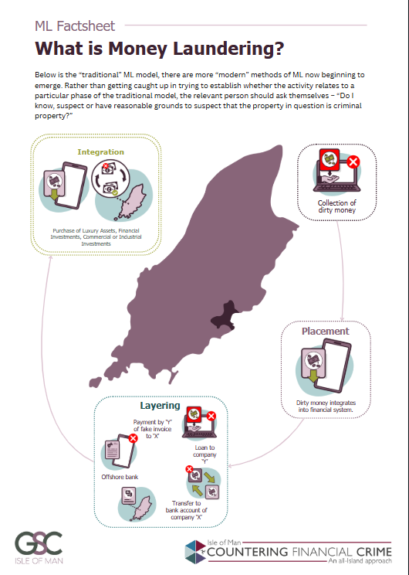
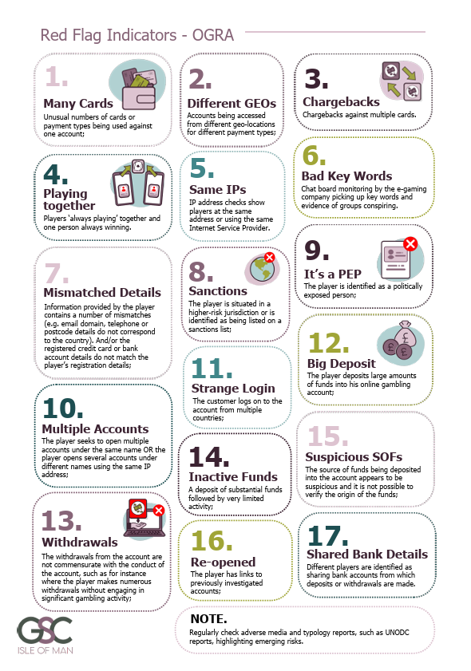
What do we plan to do?
Collaboration
Feedback: Want to ensure its effective – not just symbolic
We will continue to publish feedback and actions by the GSC
Goes both ways – Have your say & be detailed if you can!
Training for Customs & Excise (and more)
PPP – eGaming group set up with FIU
More comms, positive messaging
We published a blog outlining our goals for 2026 and what various government agencies were up to in 2025 (for more info)
We will continue publishing positive news and useful guidance in 2026
Have another lunch & Learn session with licensing team with Law Society, to boost understanding of the sector and risks.
More NRA Outreach

Slide 44
Outreach Survey

Slide 45
TF Risk Assessment

Slide 46

Terrorist Financing National Risk Assessment
National Risk Assessment – Stand alone TF assessed
Publications
Onsite Inspection Process
FIU Typologies – May 2025
Case study example

Slide 47

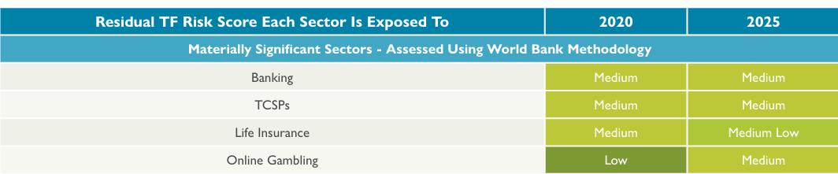
National Risk Assessment – Terrorist Financing
Release : First Standalone TF NRA - July 2025
Expectation: is to implement into own business as soon as practical
Overall assessment score in 2025 – Medium Low Risk
For Online Gambling it is Medium in 2025 from Low in 2020
Isle of Man is at more risk of being conduit – transit risk for Terrorist Financing
Top threat: transit-based terrorist financing on the Isle of Man is vulnerable due to its IFC profile.
Moneyval importance
demonstrate implementation of NRA actions
demonstrate understanding and application of the NRA

Slide 48

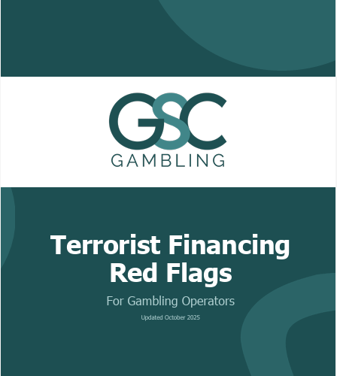
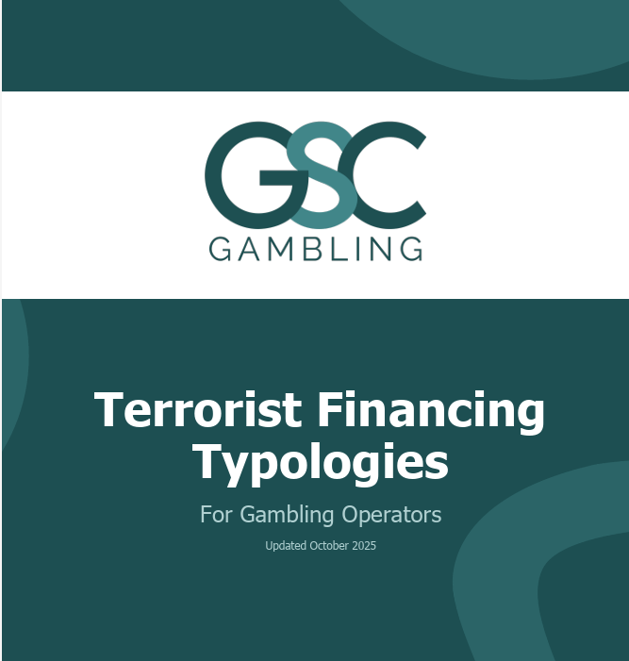
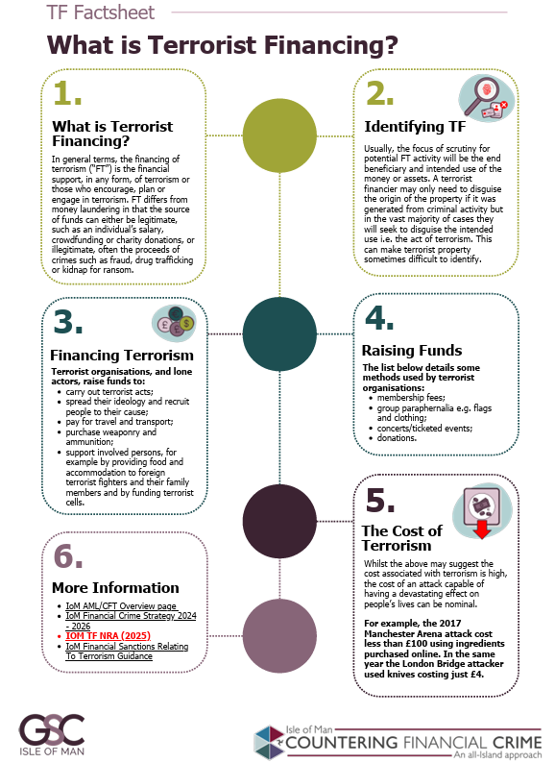
GSC – AML/CFT Publications
Publications from the GSC about TF in October 2025 - https://www.isleofmangsc.com/gambling/anti-money-laundering/aml-publications/

Slide 49




AML/CFT Inspections Process
Pre-Inspection
AML/CFT self-assessment – will expect separate referencing to TF in BRA and CRA and TRA
Relevant policies and procedures been updated
Risk Assessments updated
Training logs updated
Onsite
Risk-based approach additional questions has been added to the inspection
Expect AML/CFT staff to be aware of requirements
Suspicious Activity Reporting process updated?
Post-inspection
Reports will reflect if new TF requirements has been implemented

Slide 50
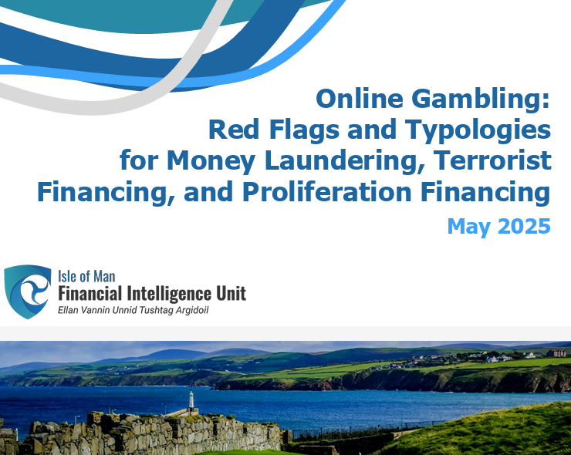

Slide 51

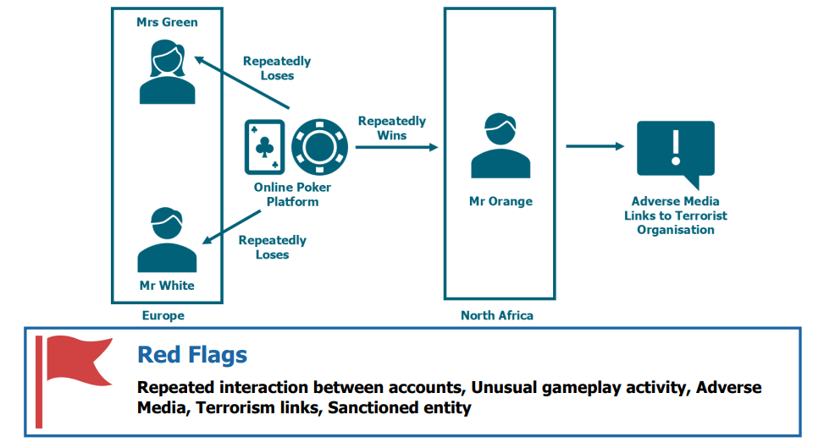
Case Study

Slide 52

Thank you

Slide 53
Q&A Session

